Slide 1
Virtual Linac Validation 2020 TrueBeam 6X FFF

Slide 2
Measured data from Antti Kulmala (2016)
SSD = 95cm
40 x 40 x 40 cm³ Blue Phantom 2® -water phantom system
Photon PDDs for field sizes: 3 x 3 cm², 4 x 4 cm² and 5 x 5 cm² and CRs for field size 5 x 5 cm², have been measured with diode detector.
All other photon beam data is measured using ionization chamber.
Estimate that the combination of uncertainty is ≤ 0.5 % (1σ) for all studied photon beams.
Setup uncertainty is estimated to be ± 0.5 mm (for water phantom and detector separately).

Slide 3
100 x batch:
Number of threads 30
Number of events 550000
Simulation time ≈ 1h
Full directional biasing used
SSD = 95cm
Field sizes: 3x3, 4x4, 5x5, 6x6, 10x10, 20x20, 40x40
Scoring grid size (x,y,z) = (1mm, 10mm, 1mm)

Slide 4
Electron beam properties
Electron energy: 6.5MeV
Energy sigma: 0.056 MeV
Spot size: 0.6645mm x 0.7274mm
Angle divergence: 0.0573°
Determined by T. Ikonen

Slide 5
PDDs

Slide 6
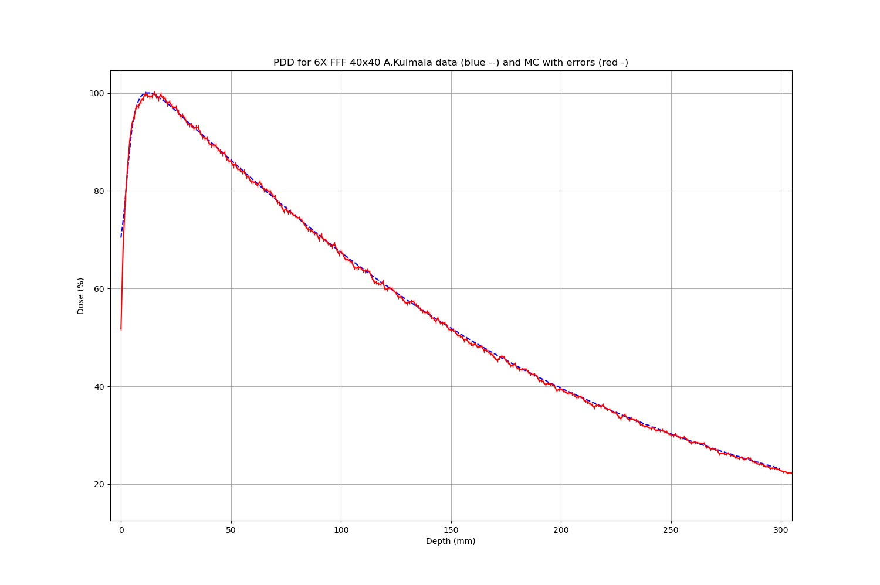

Slide 7
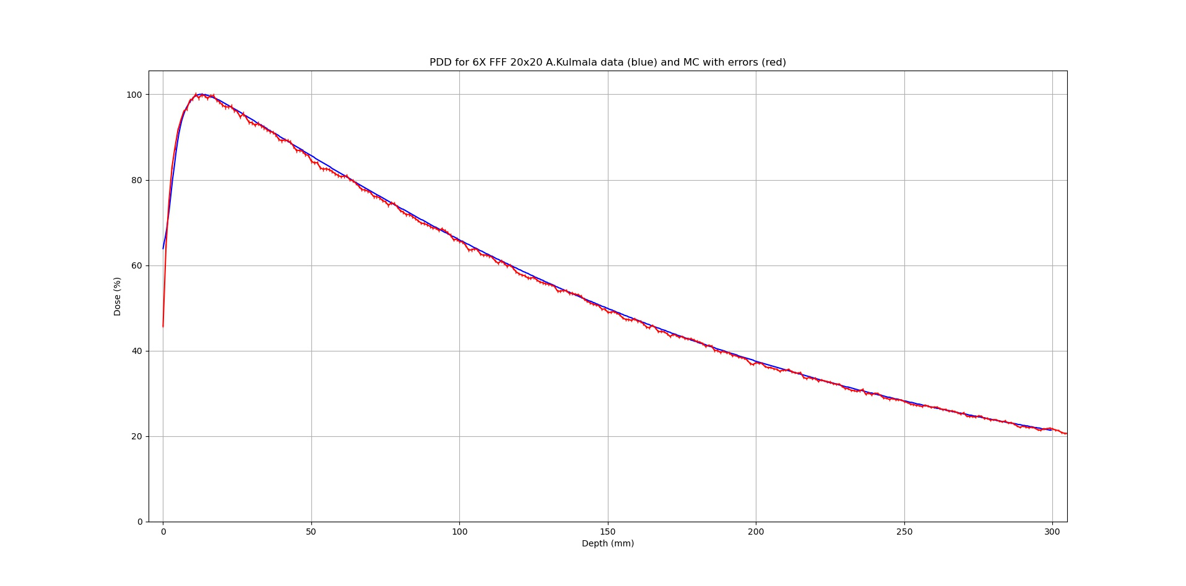

Slide 8
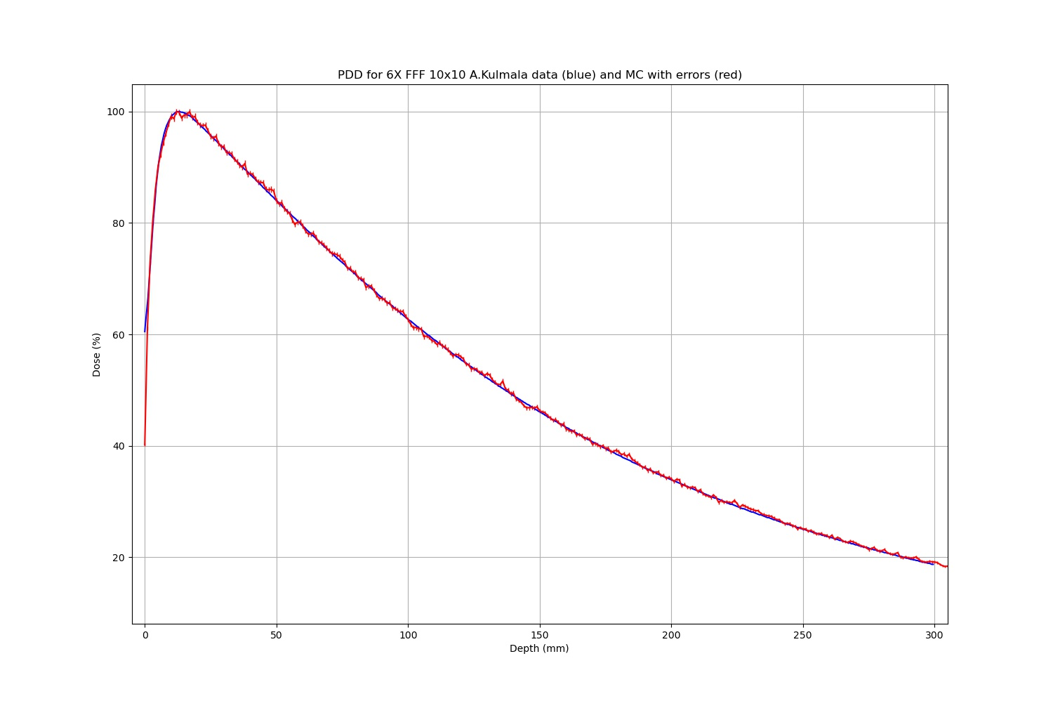

Slide 9
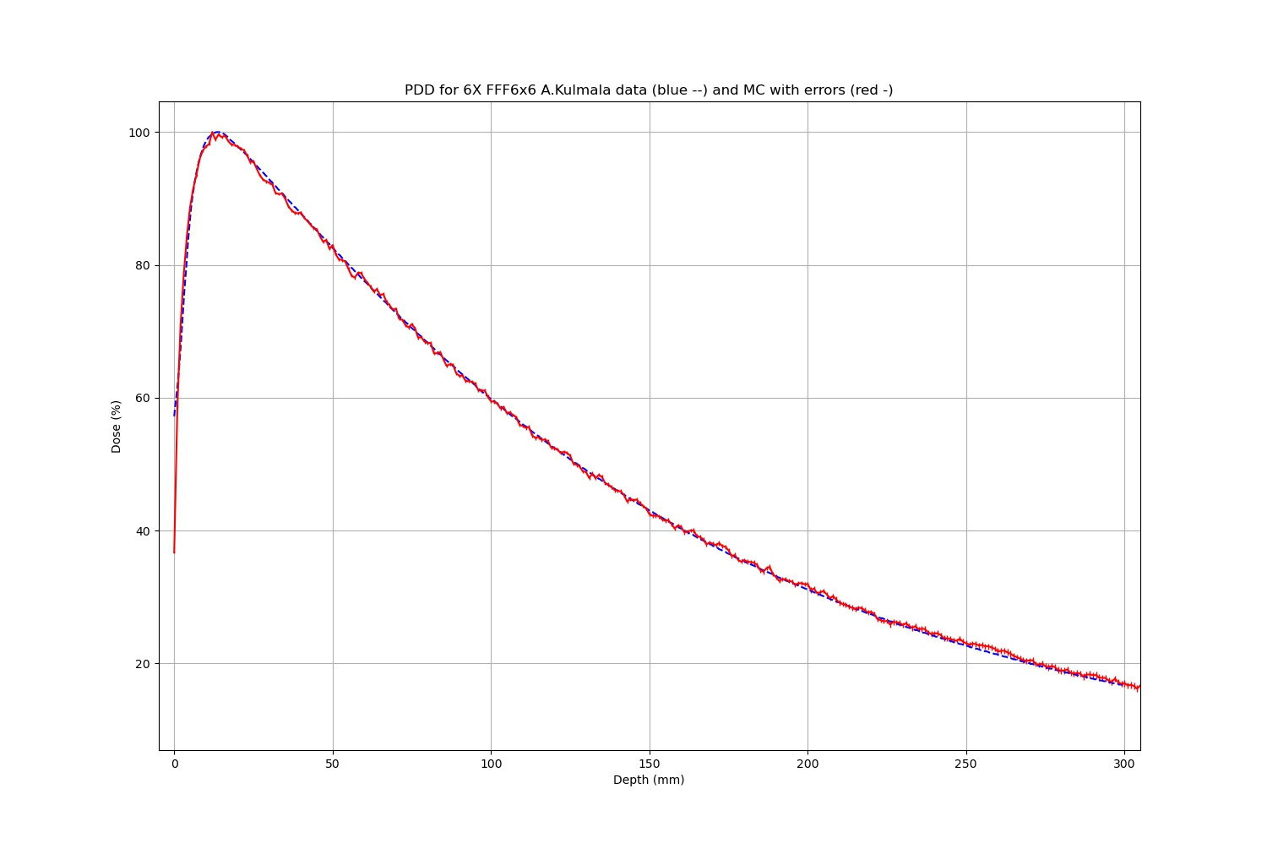

Slide 10
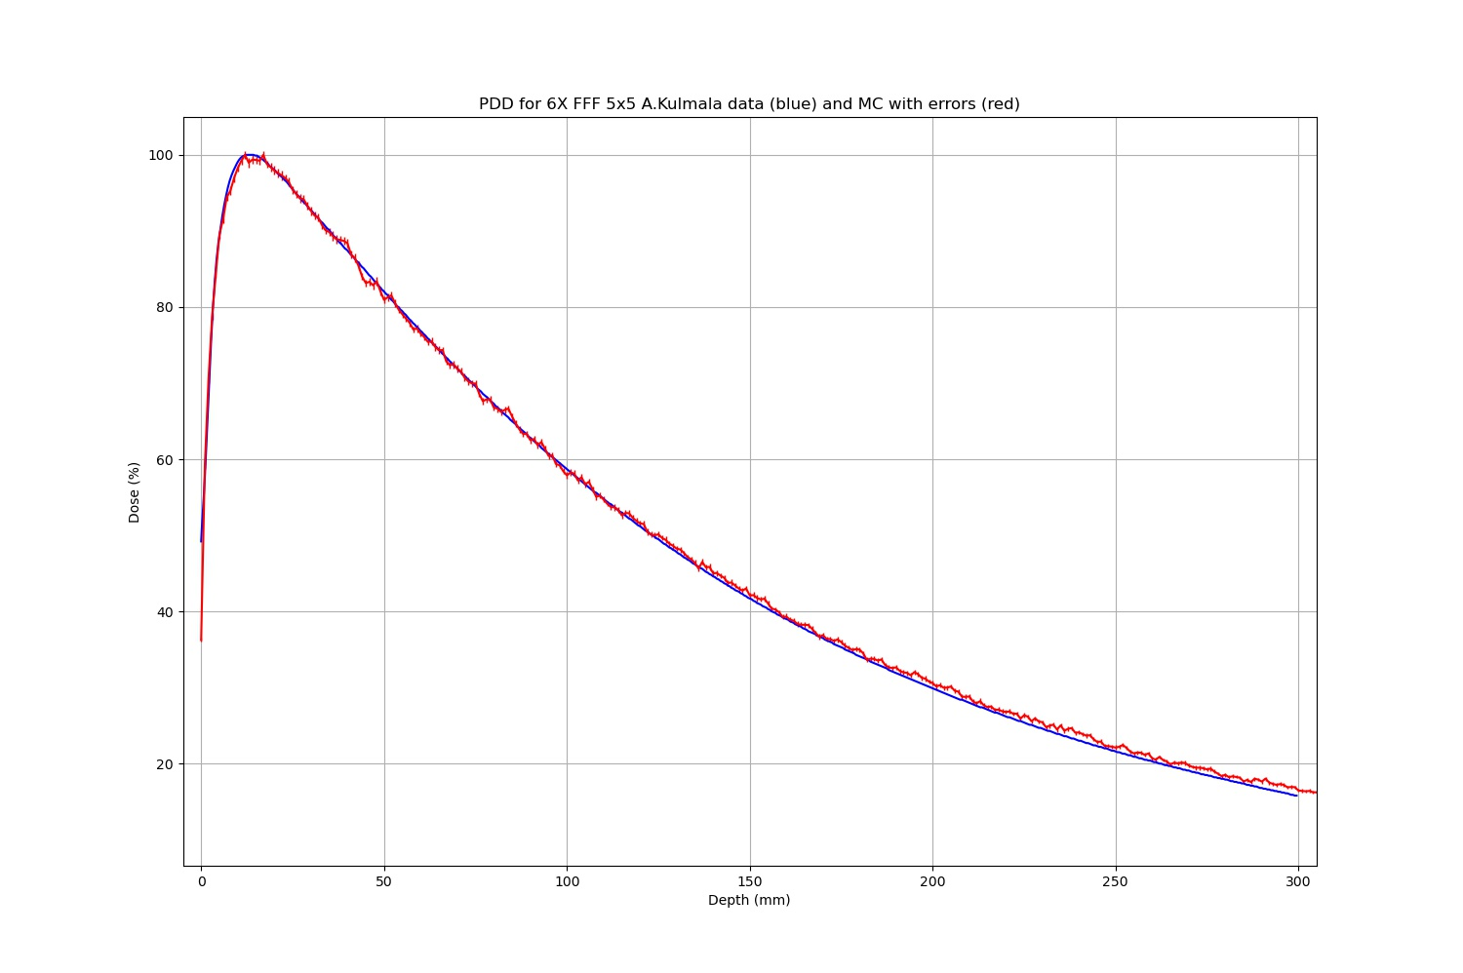

Slide 11
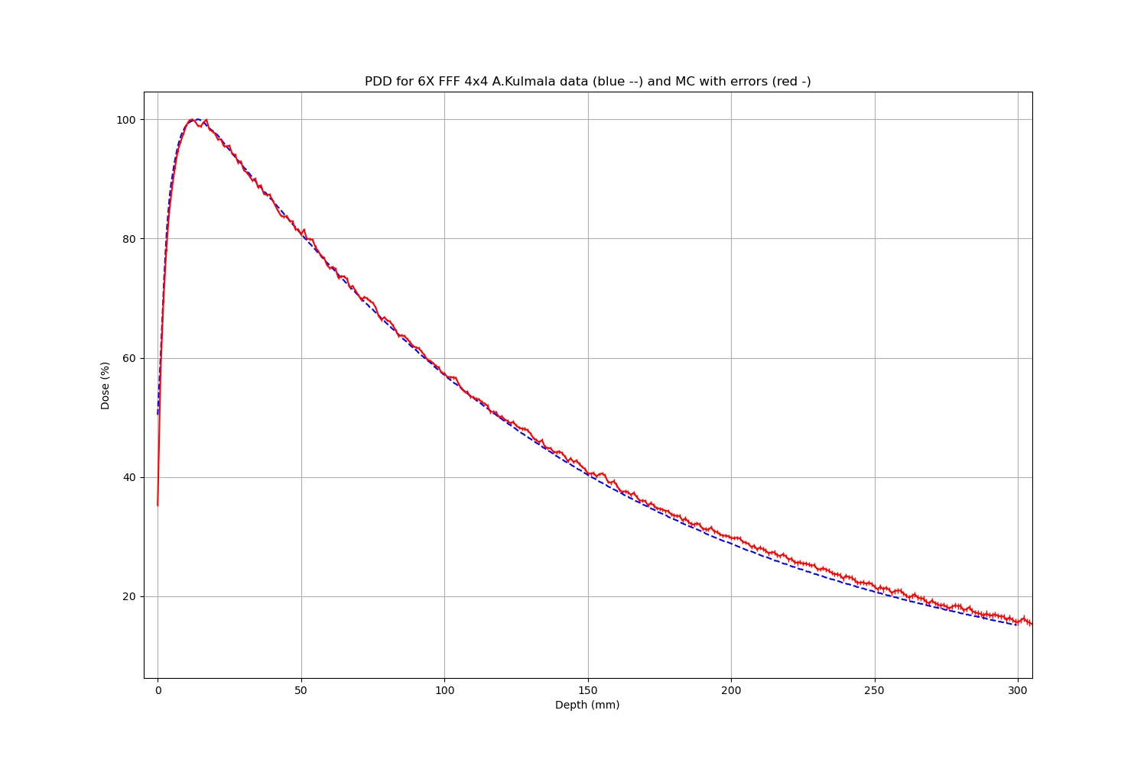

Slide 12
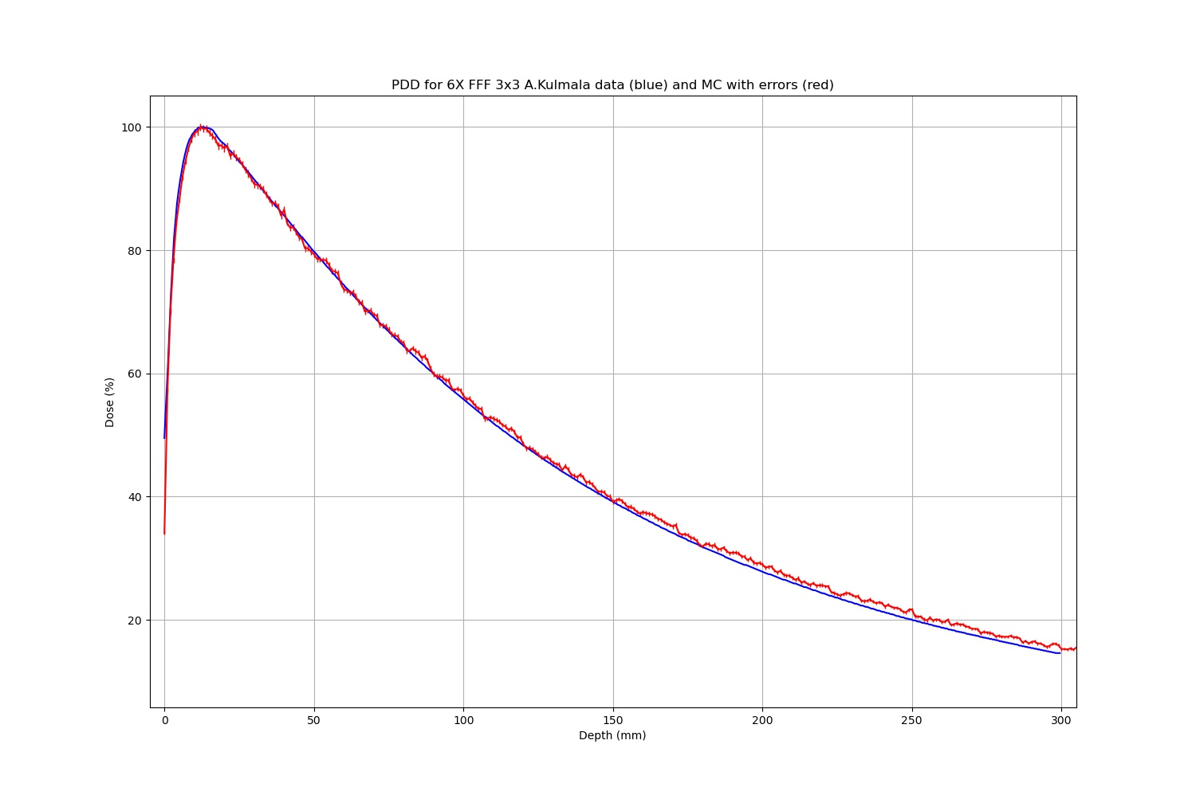

Slide 13
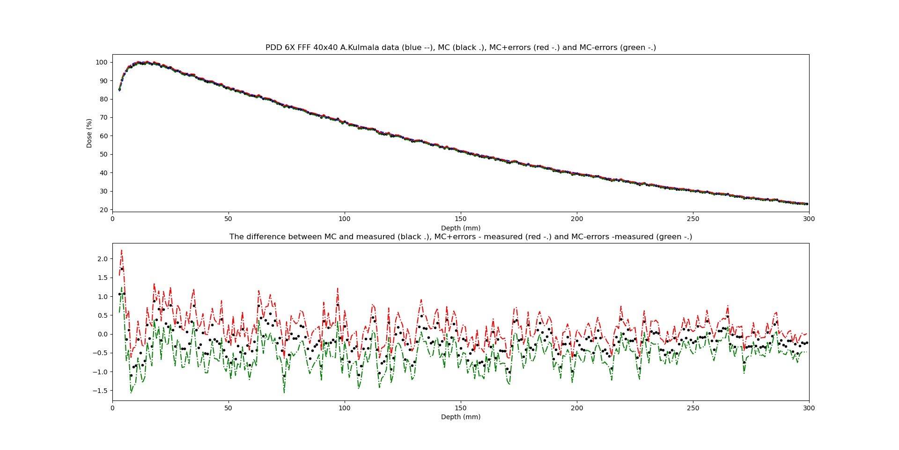

Slide 14
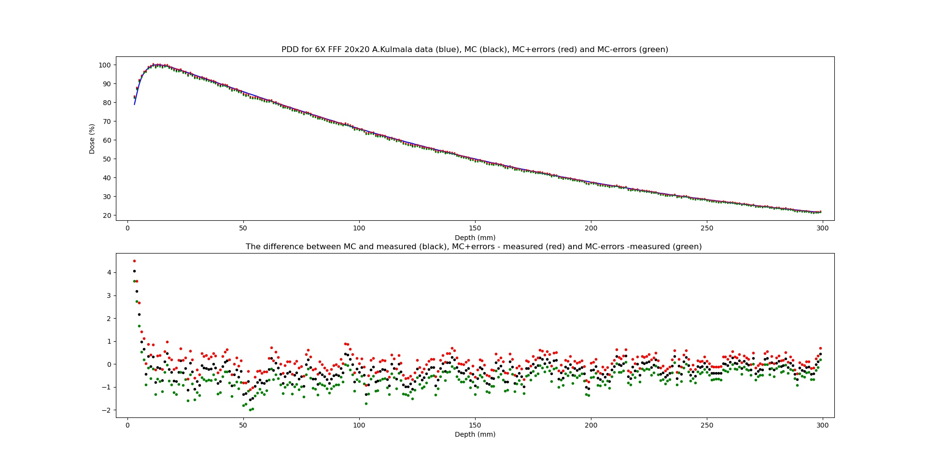

Slide 15
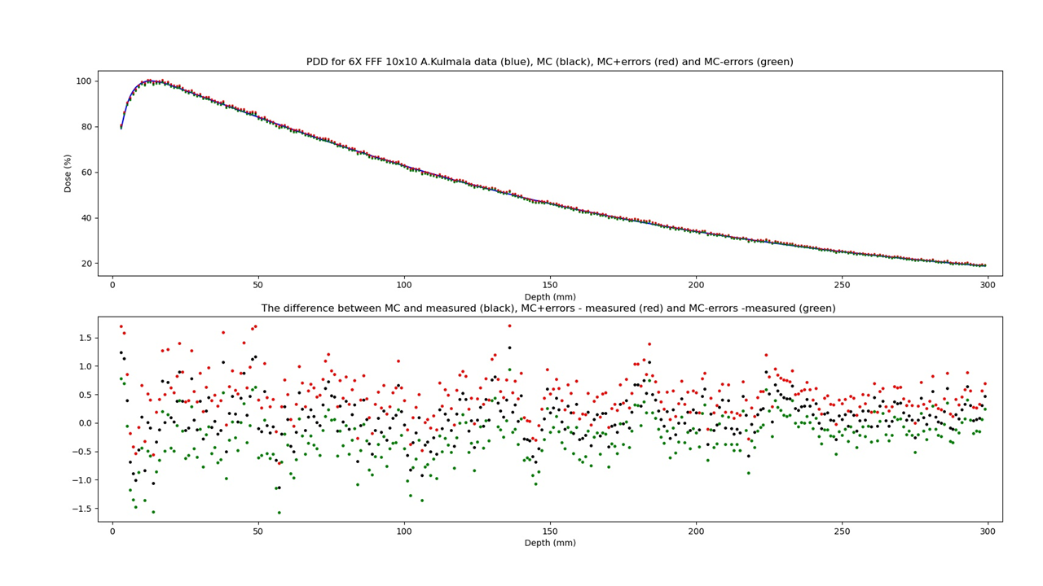

Slide 16
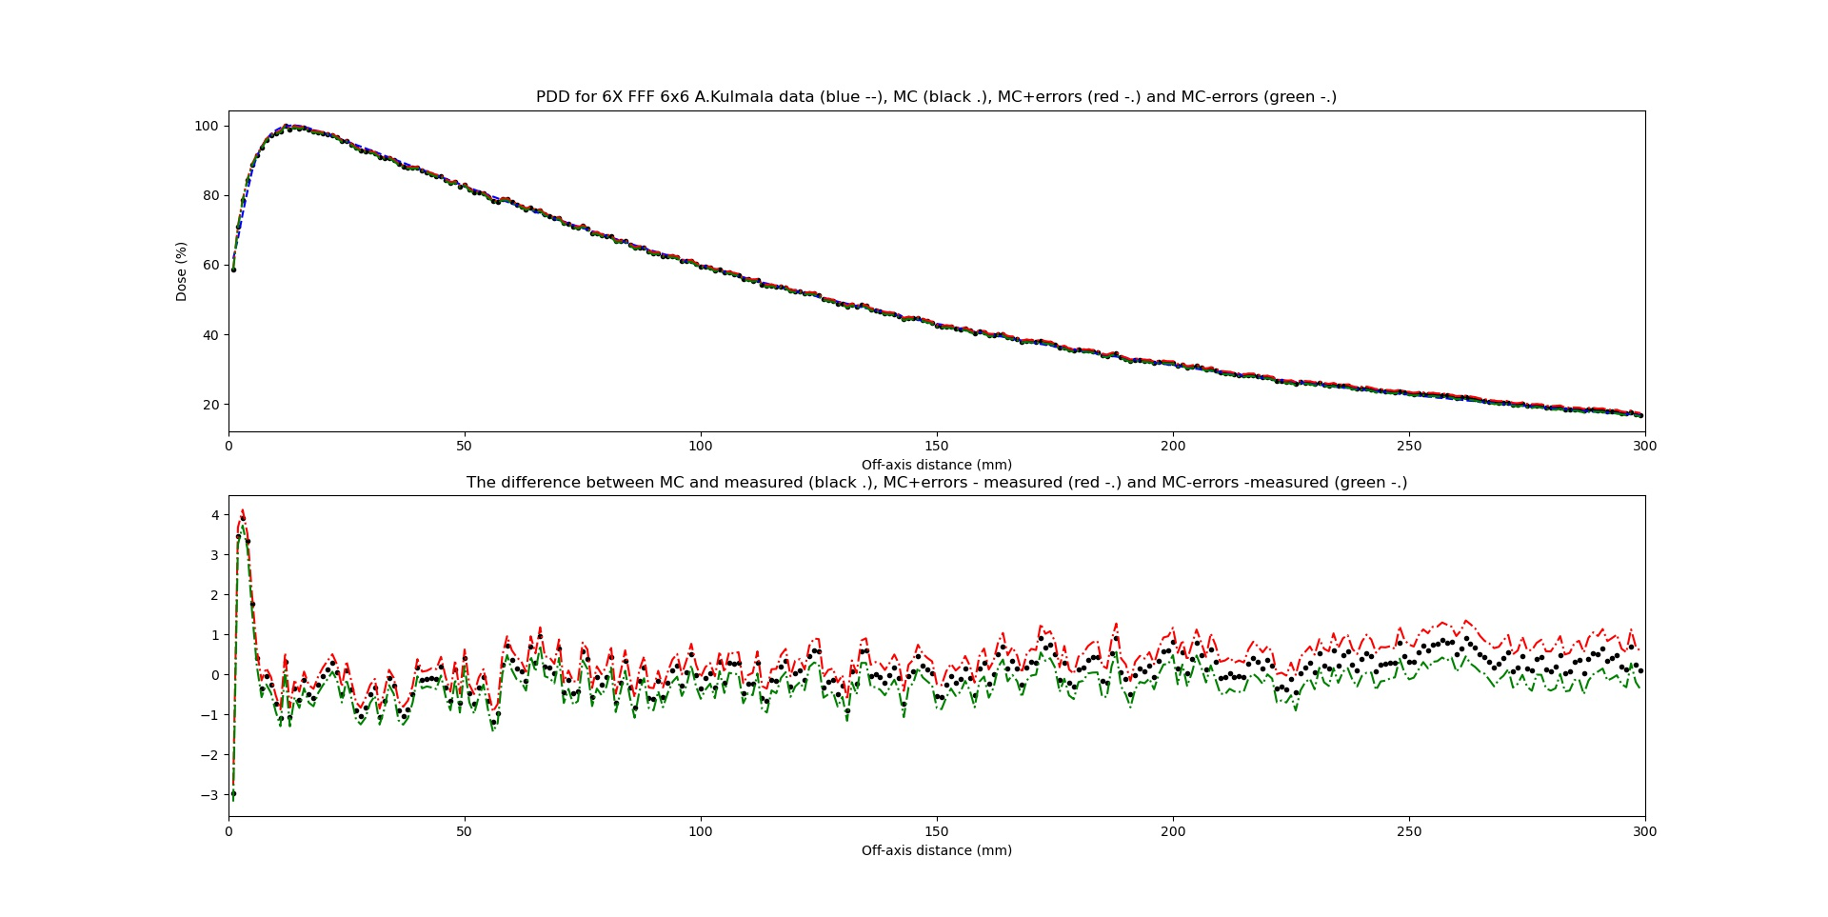

Slide 17
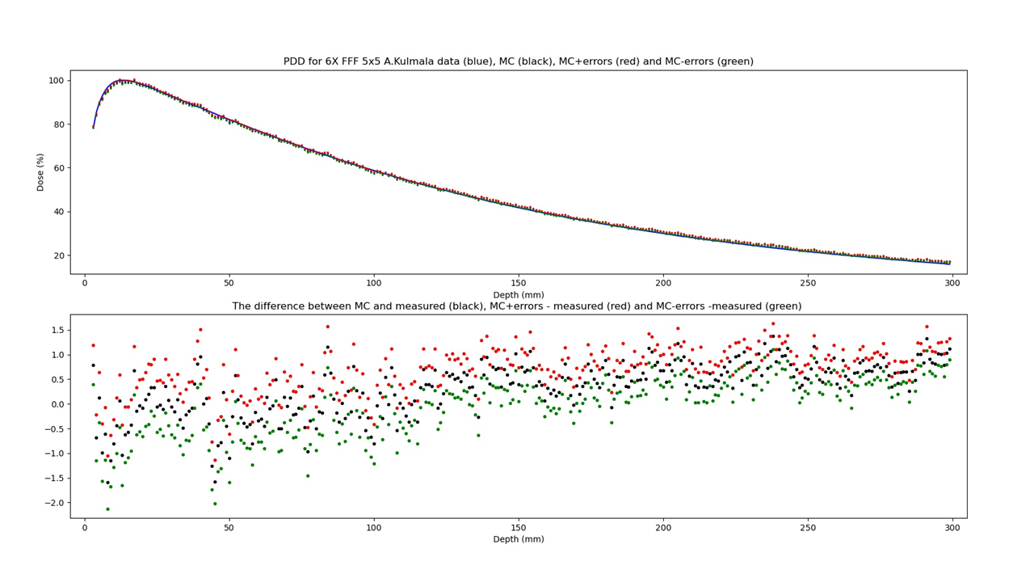

Slide 18
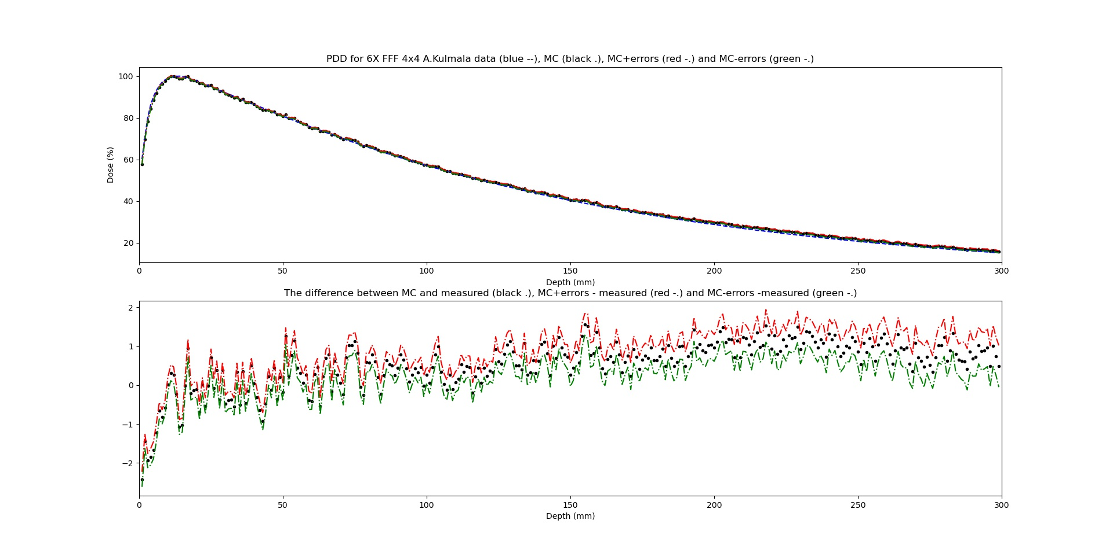

Slide 19
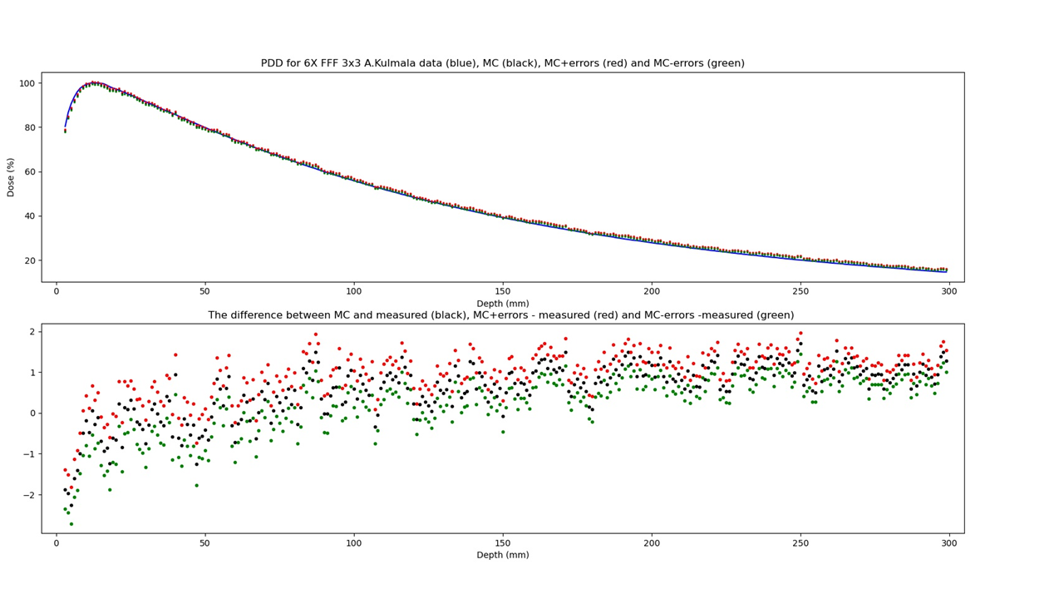

Slide 20
Dose profiles

Slide 21
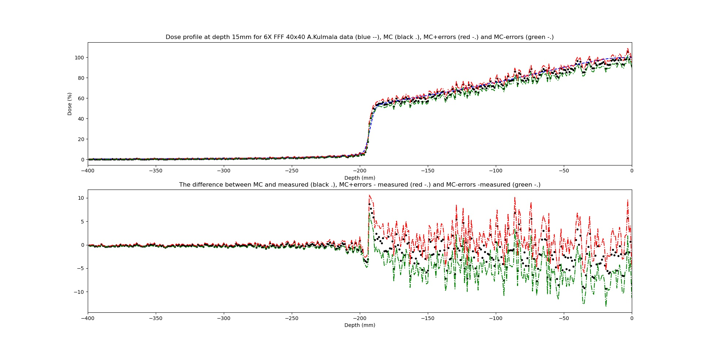
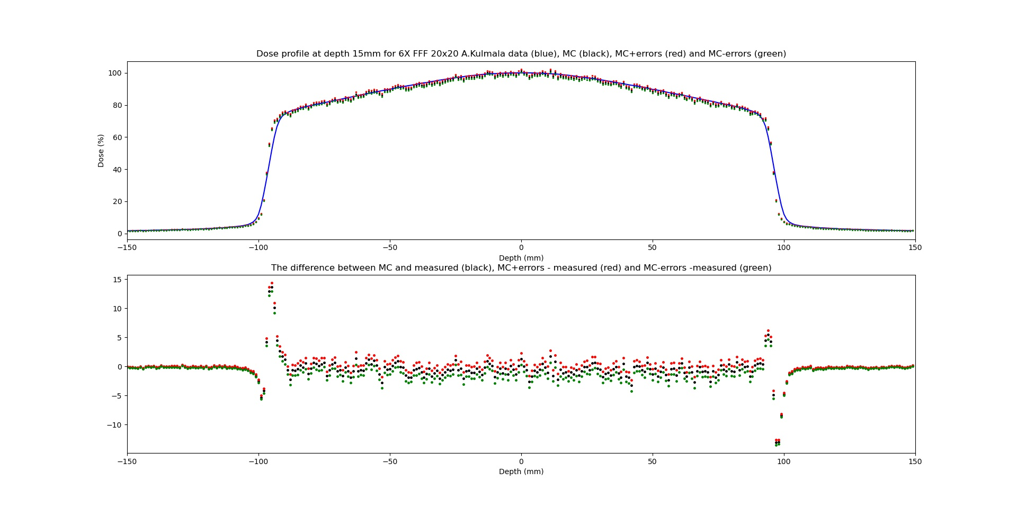
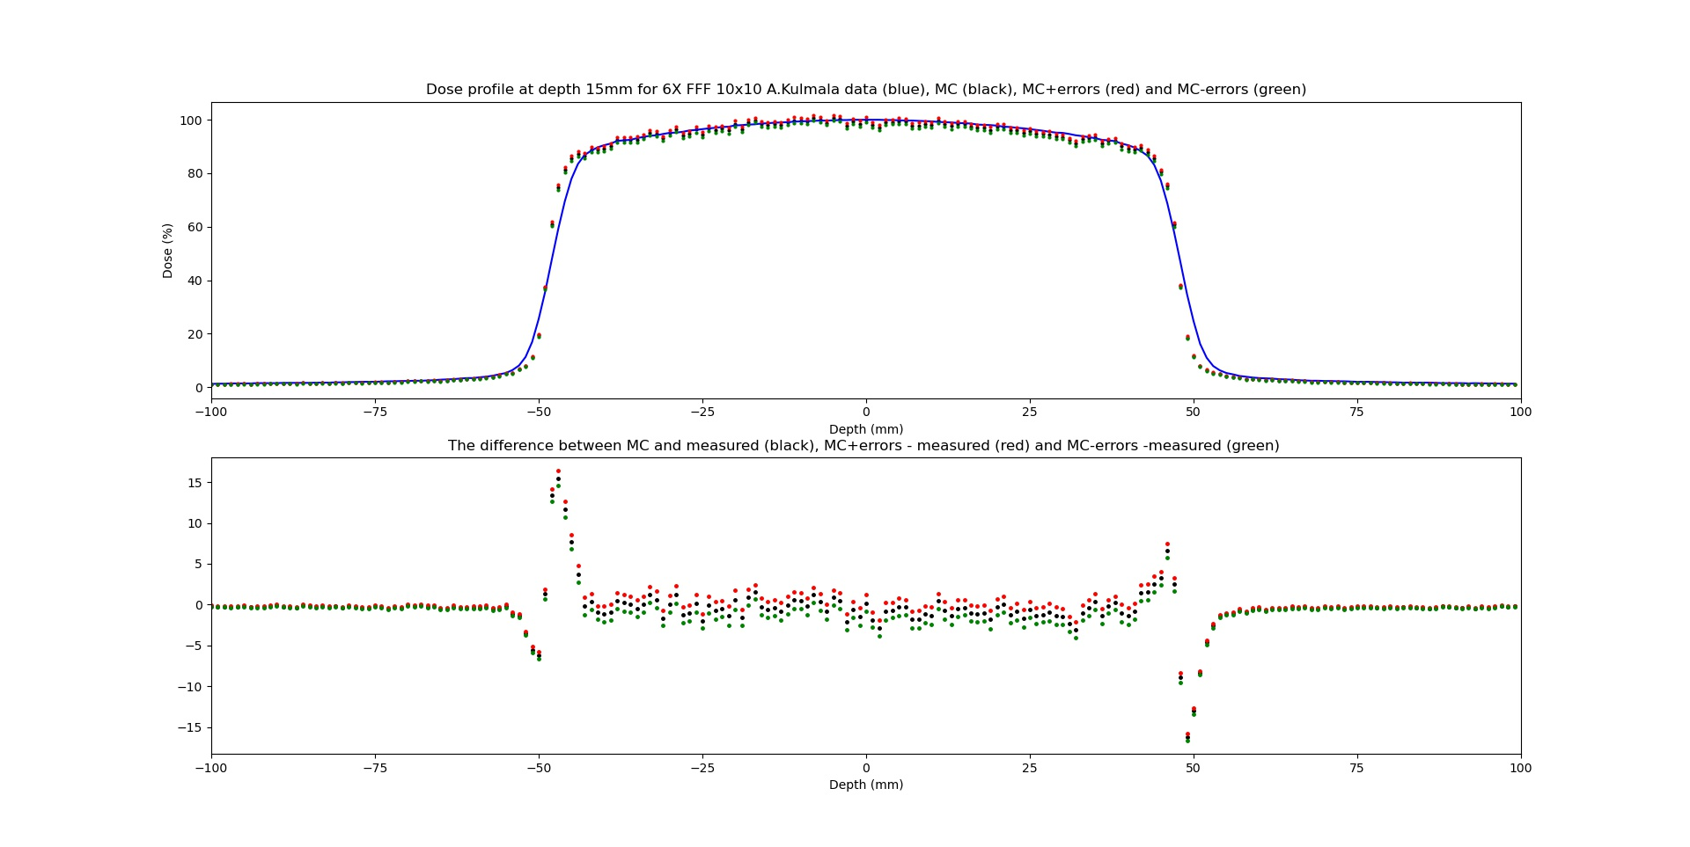
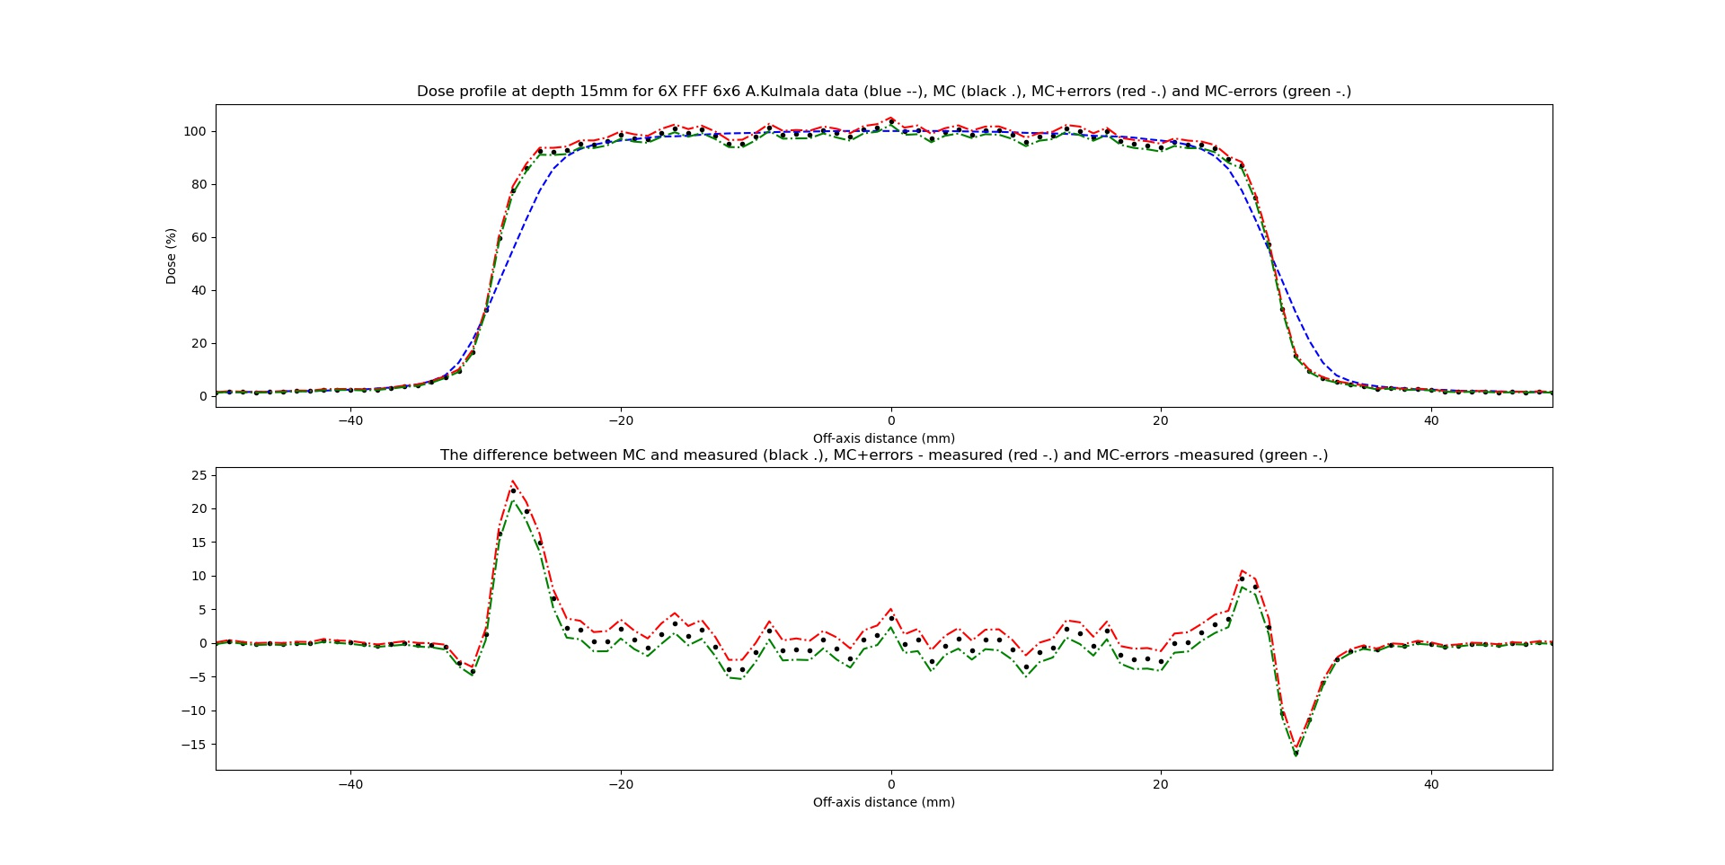
At depth 15 mm

Slide 22
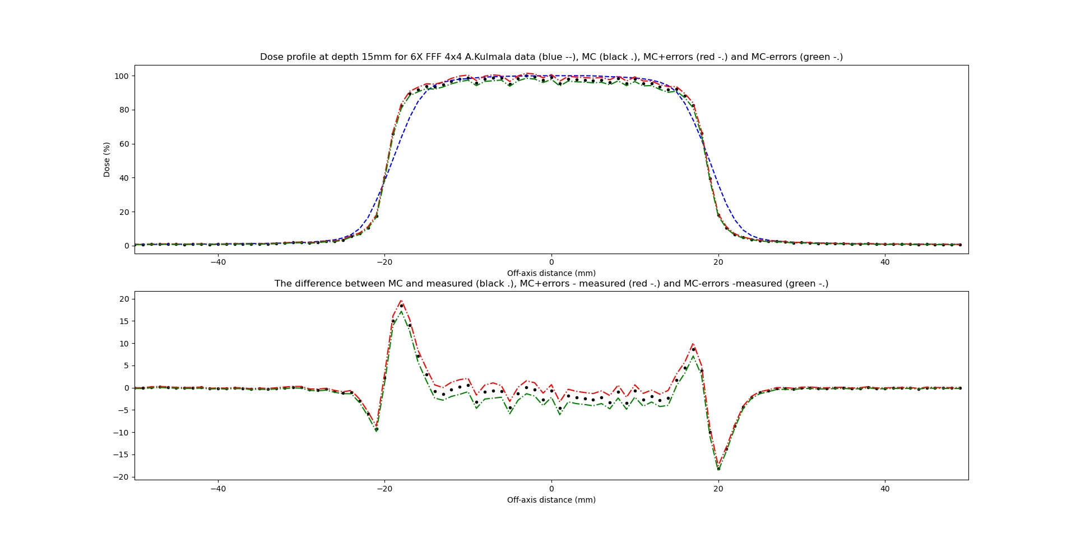
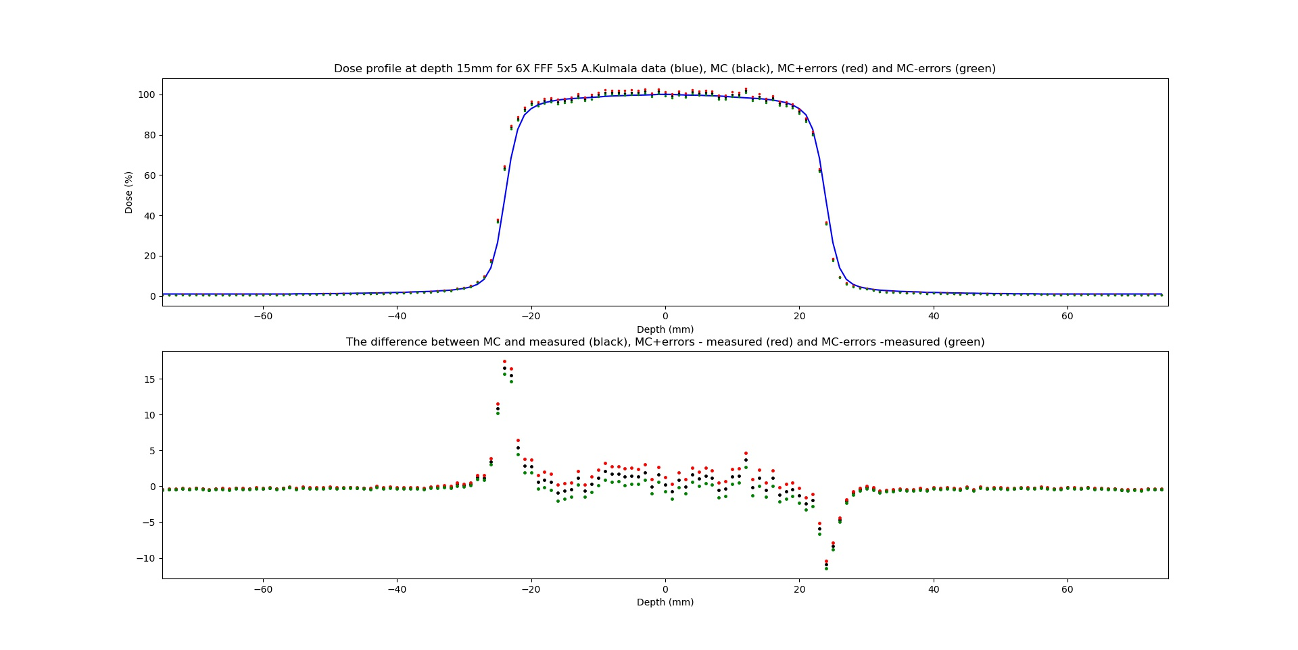
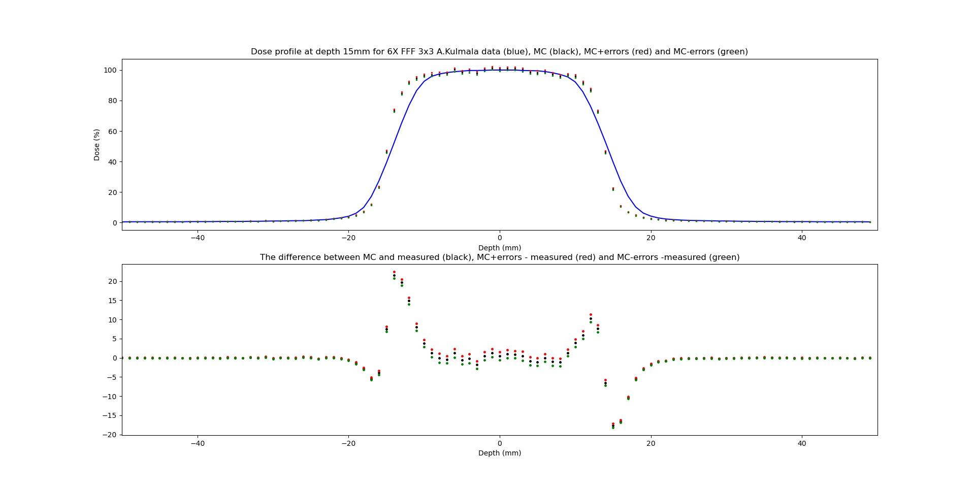
Field size 5 x 5 cm² is been measured with diode detector

Slide 23
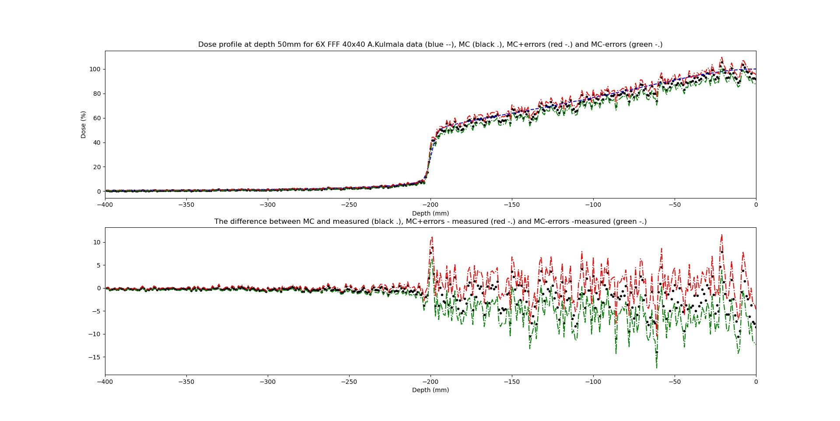
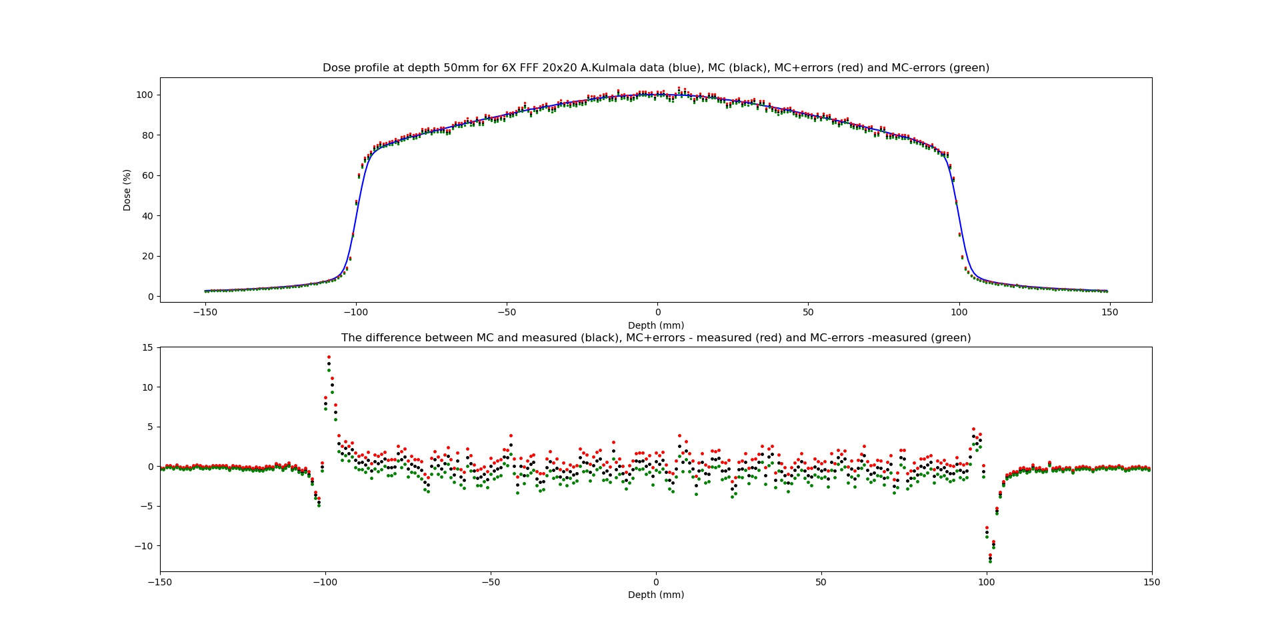
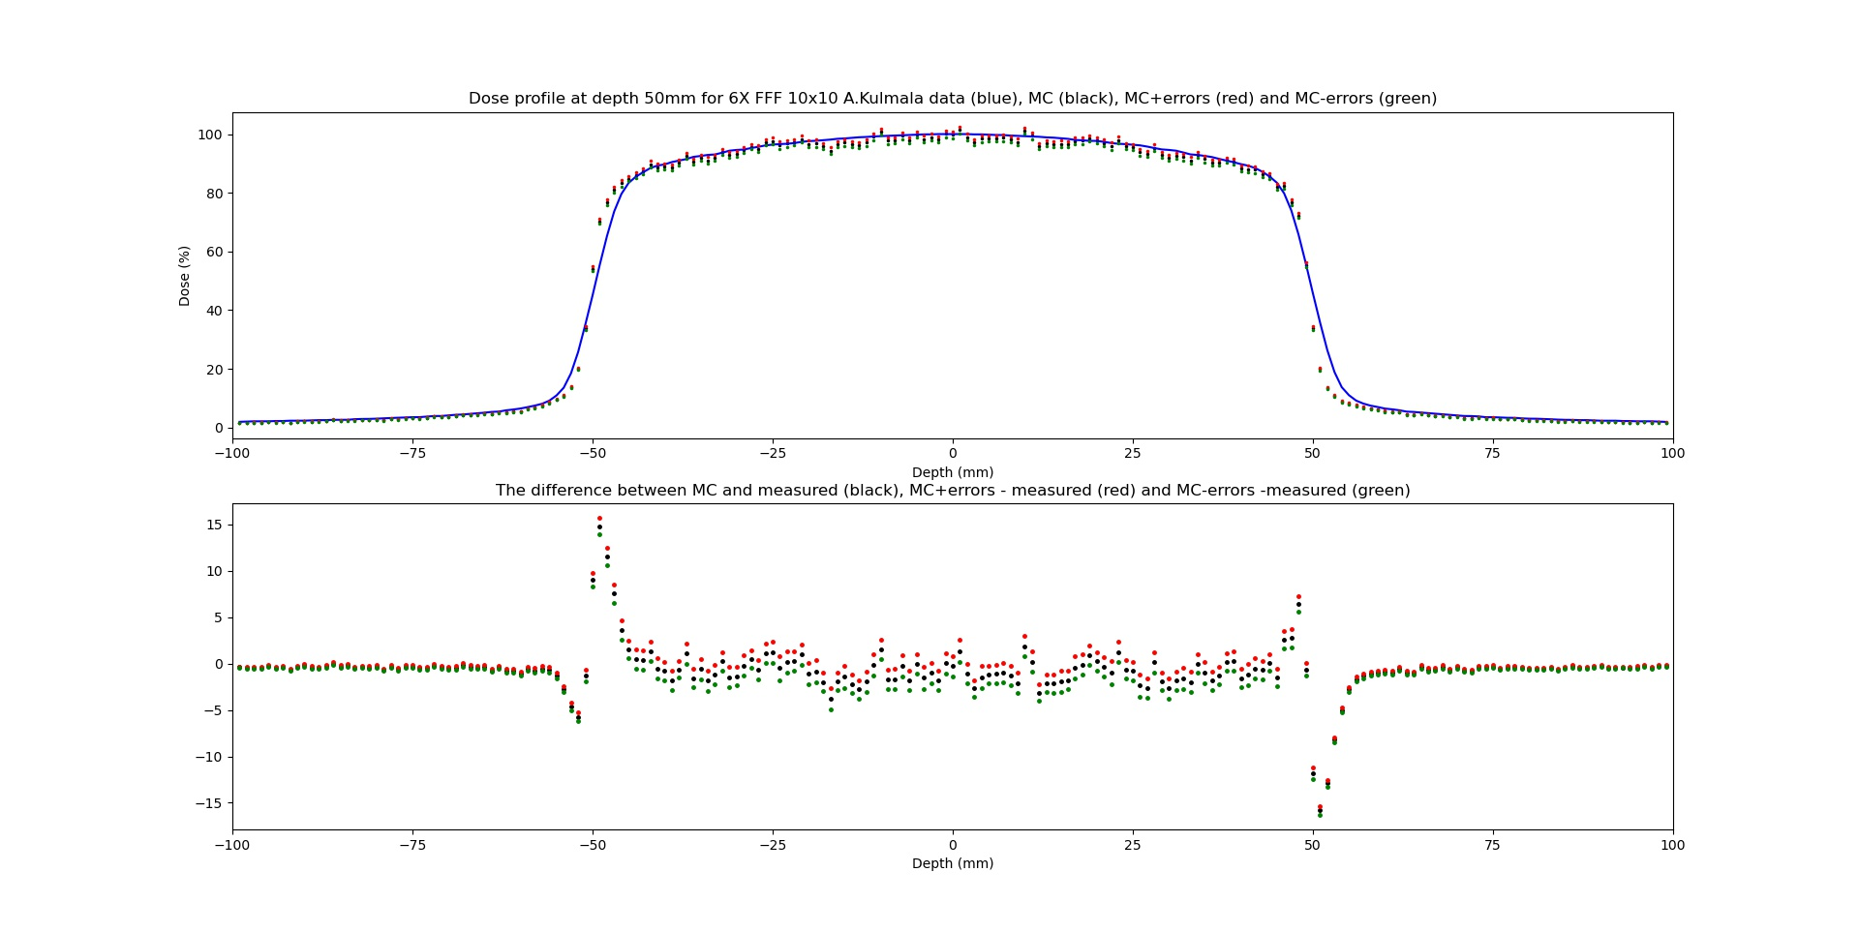
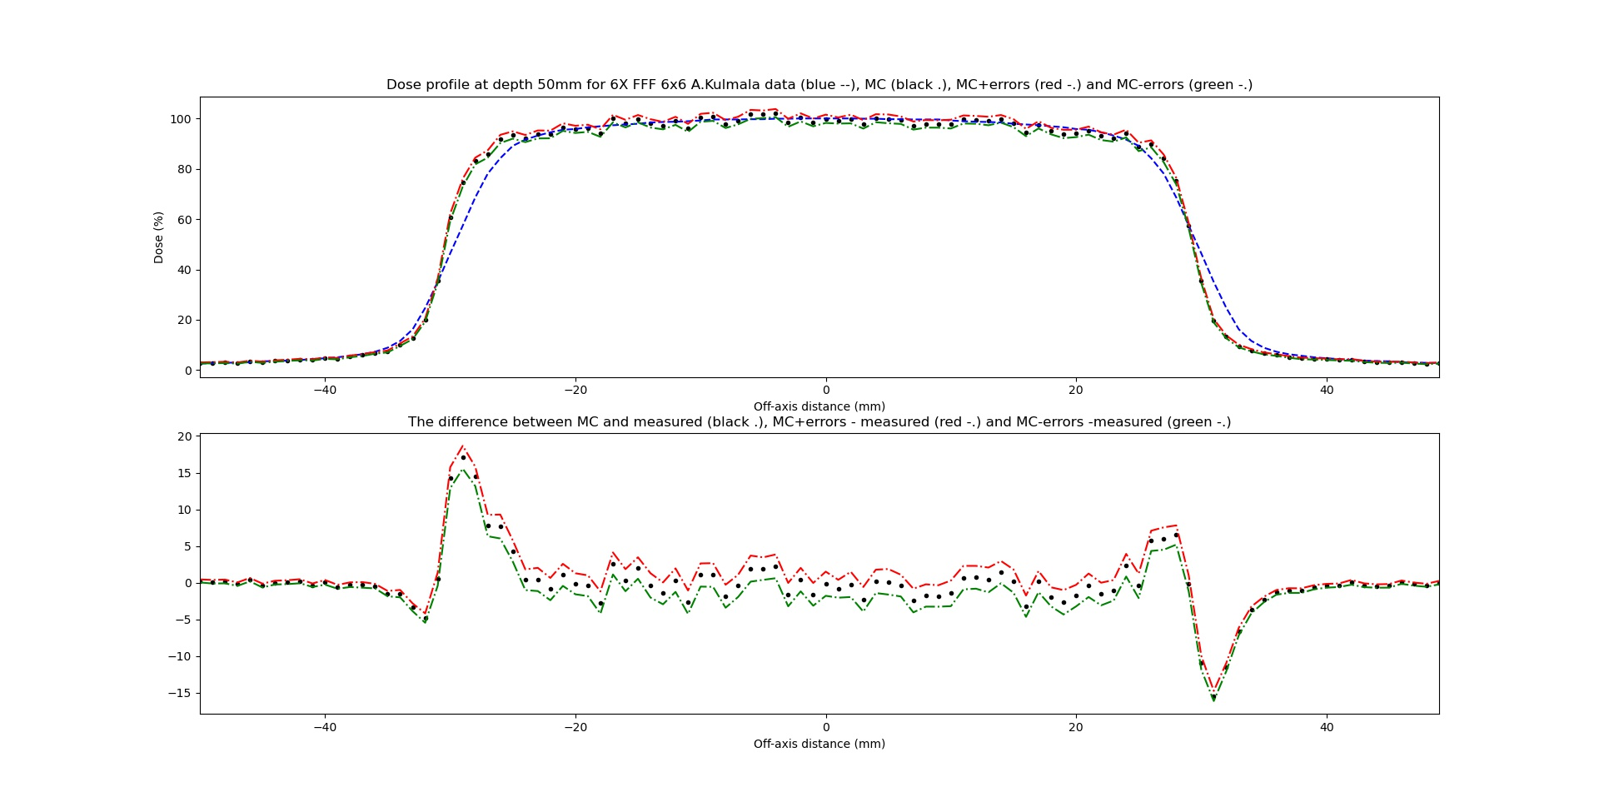
At depth 50 mm

Slide 24
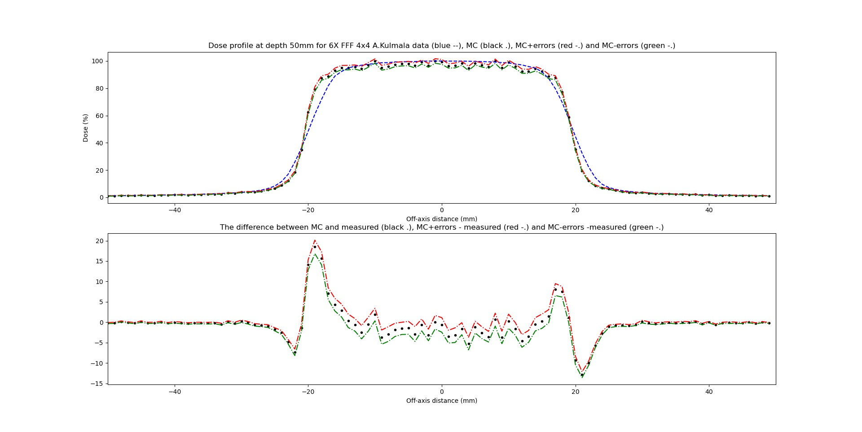
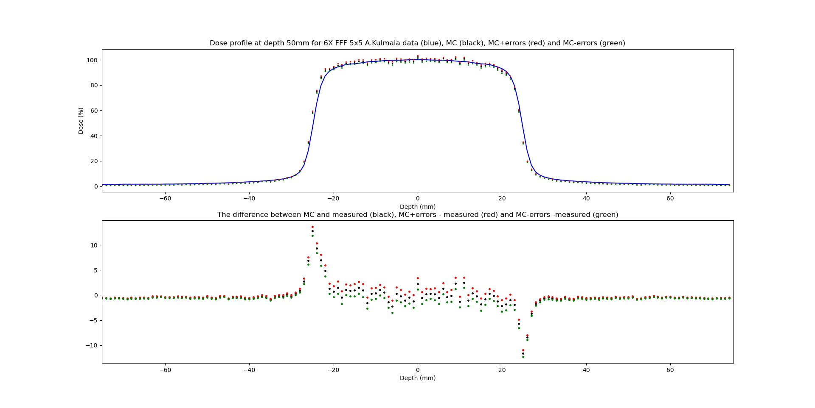
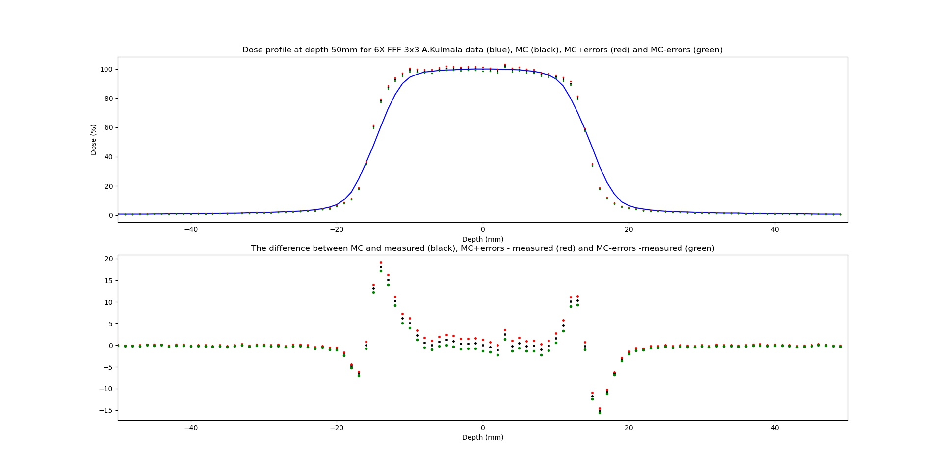

Slide 25
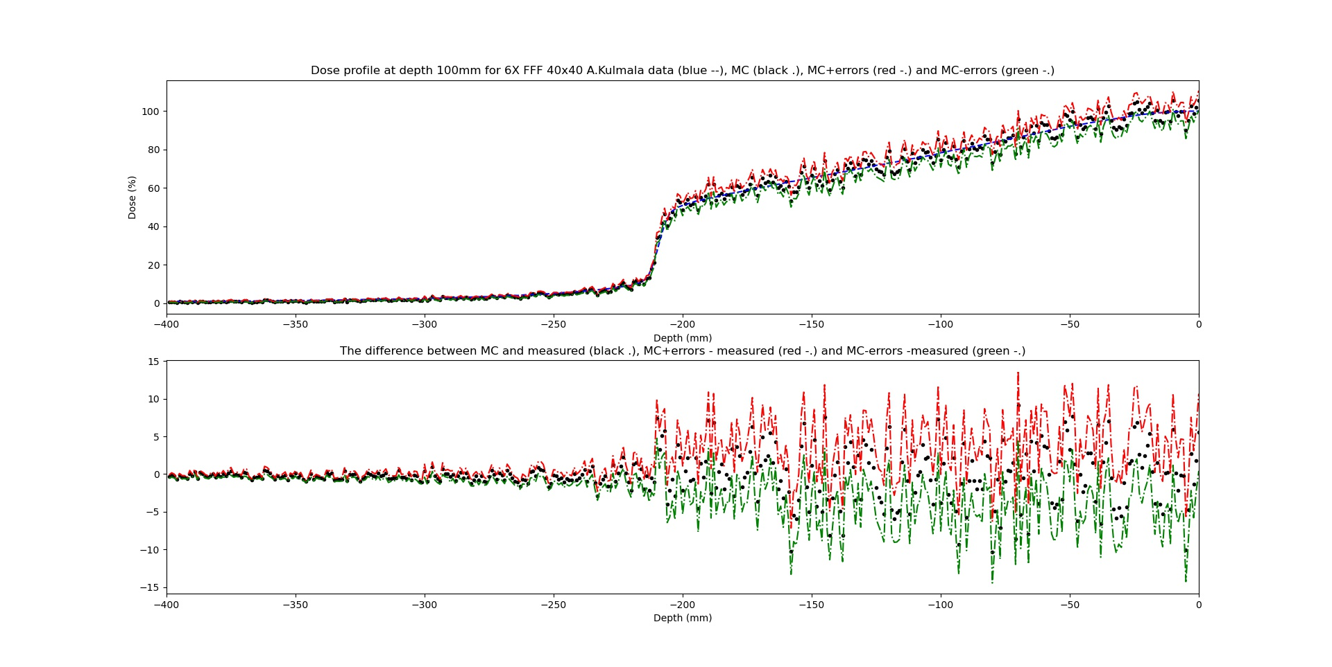
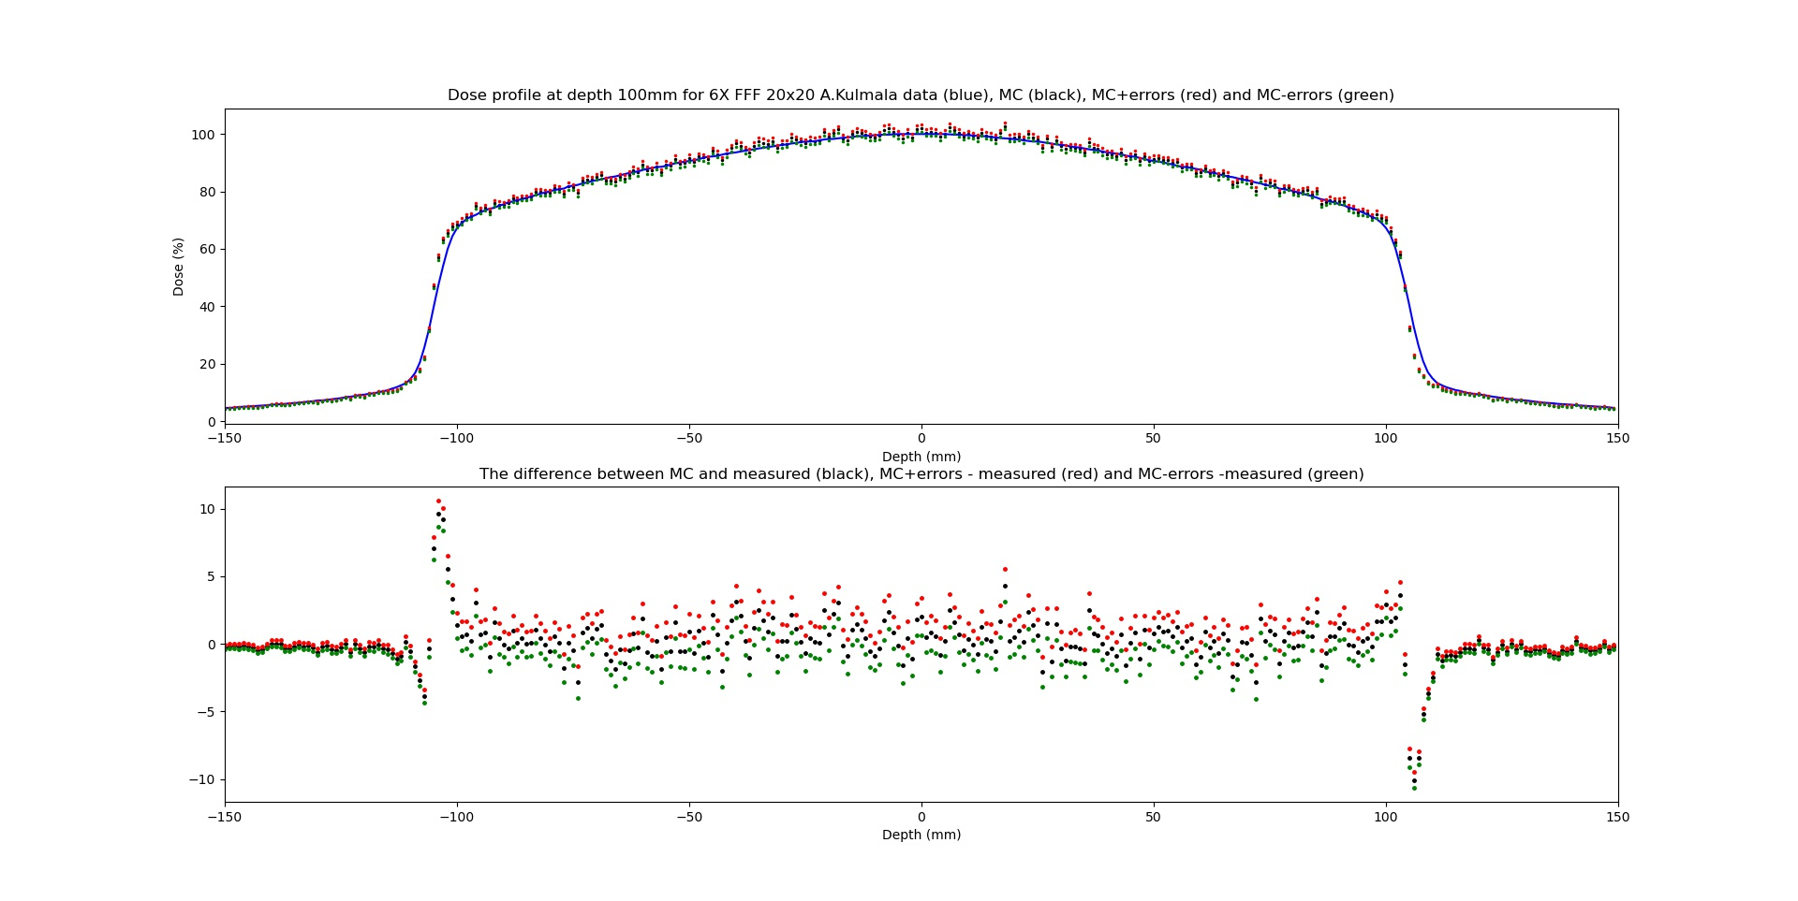
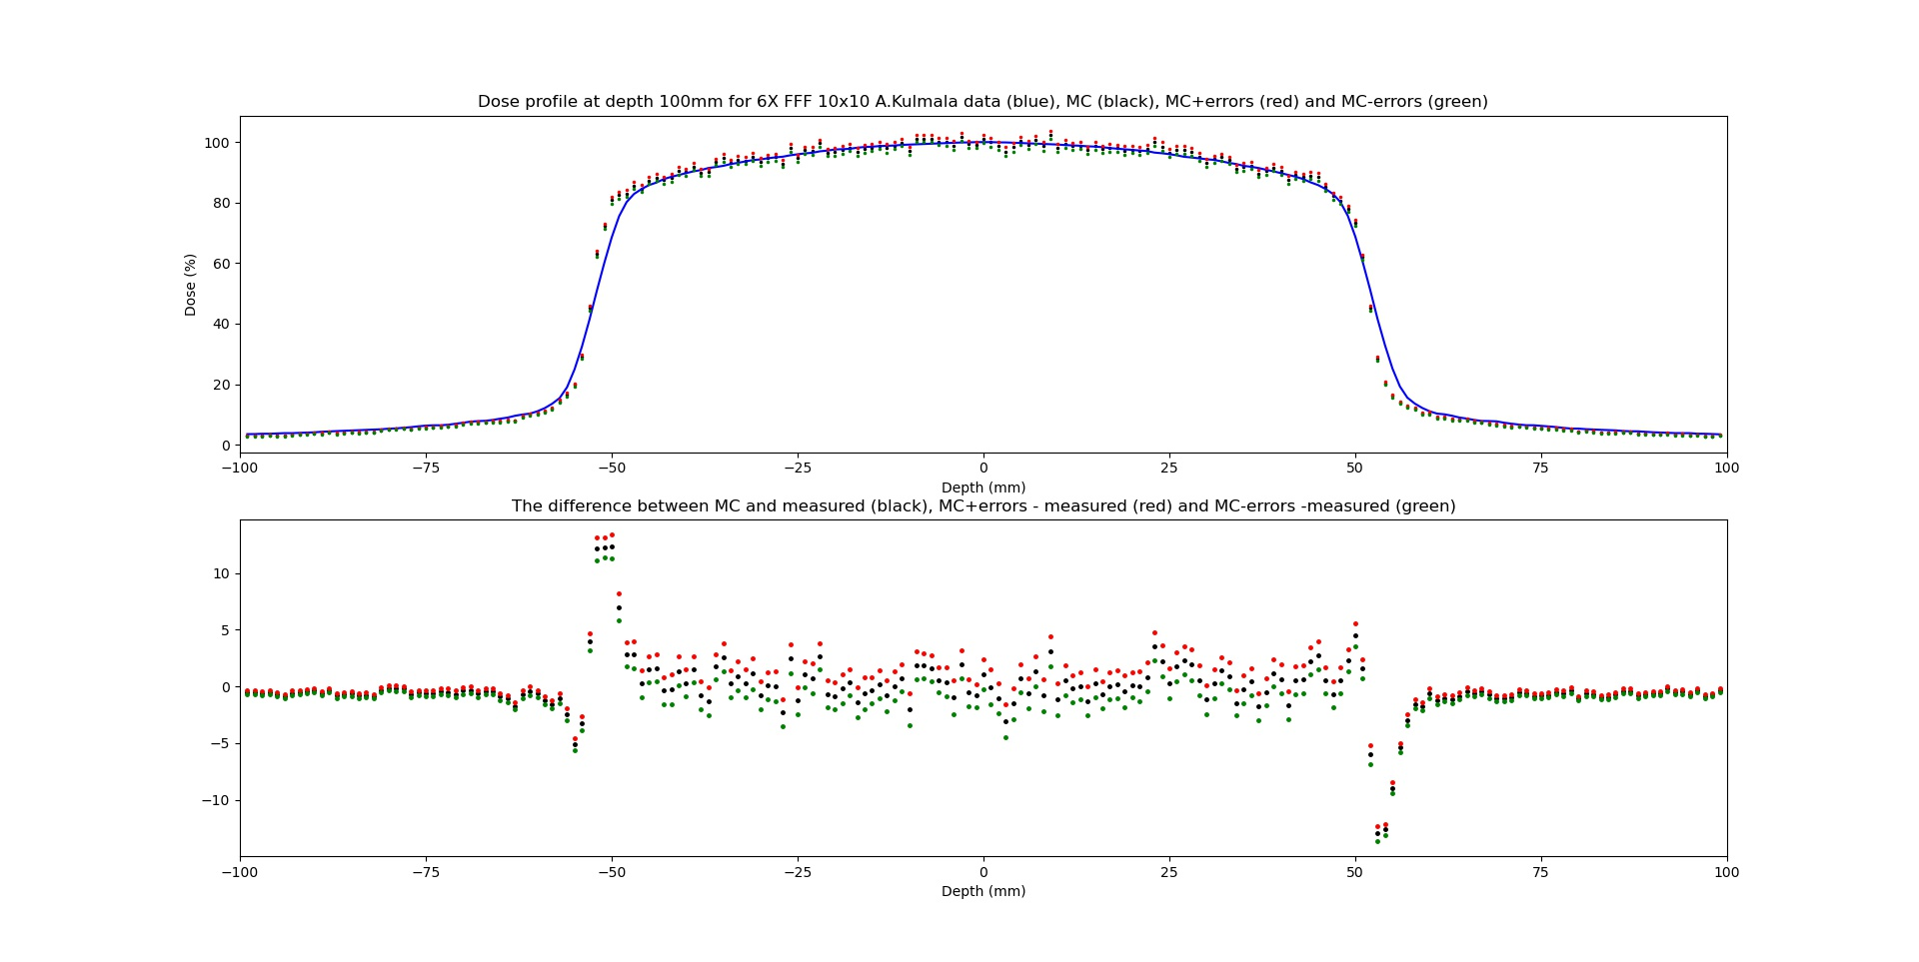
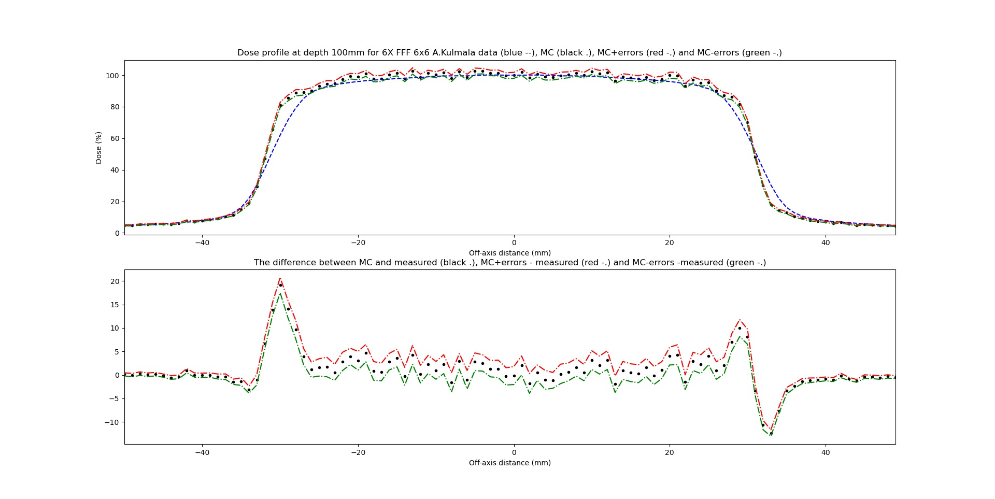
At depth 100 mm

Slide 26
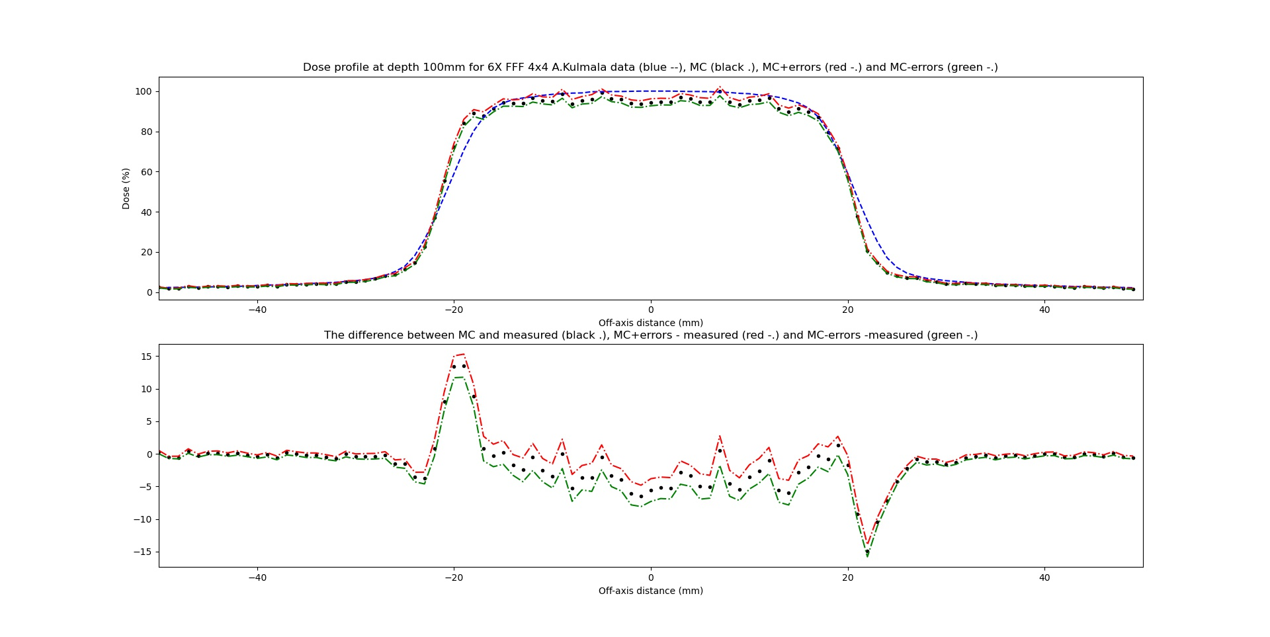
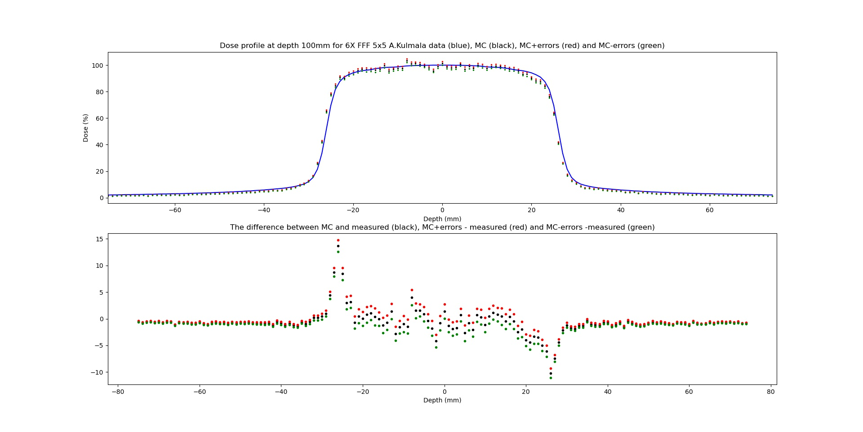
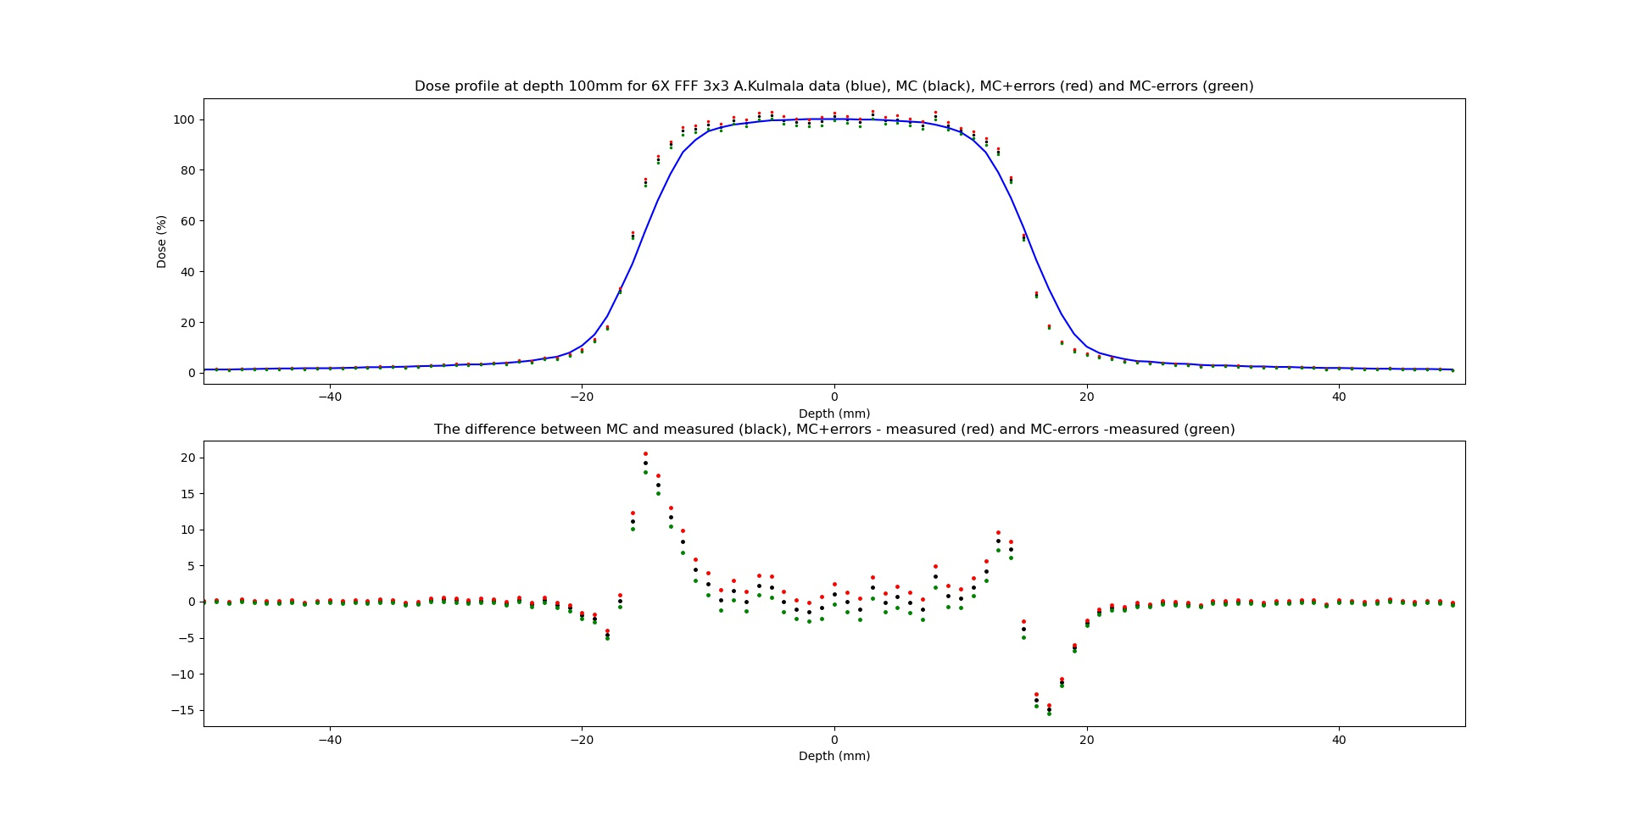

Slide 27
Convolving the number of voxels corresponding to the detector size (±3mm)

Slide 28
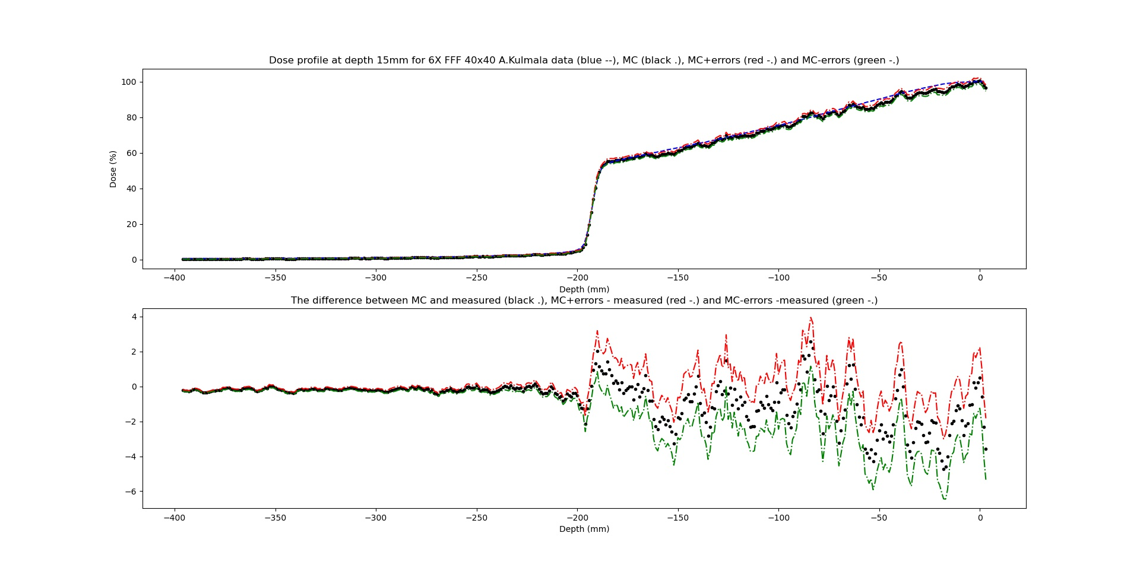
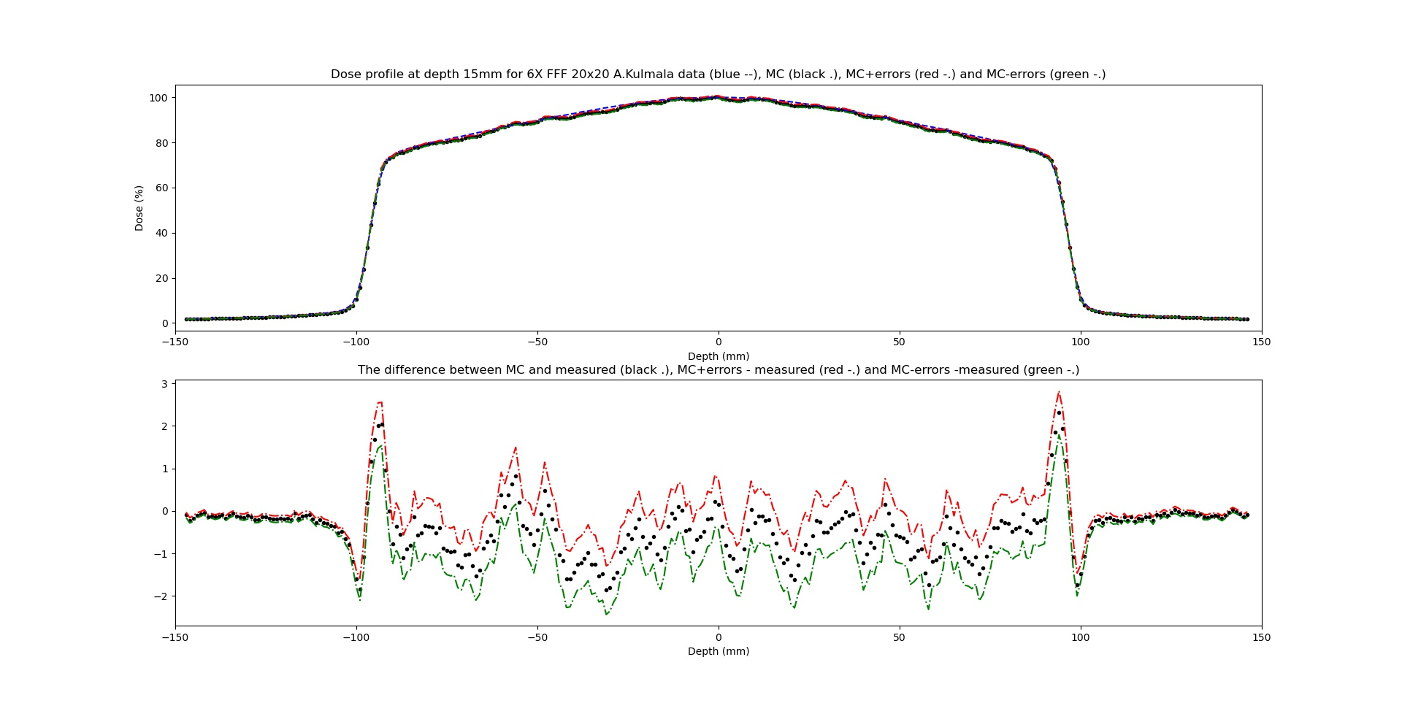
At depth 15mm without (left) and with convolution(right)

Slide 29
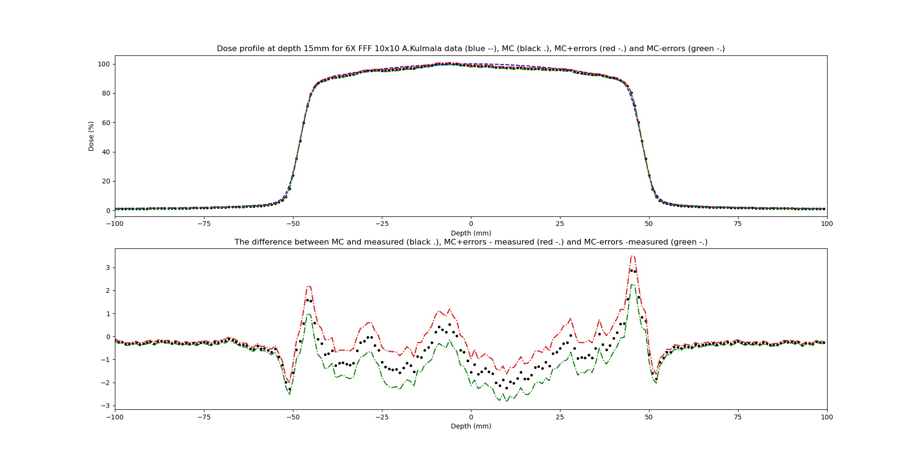
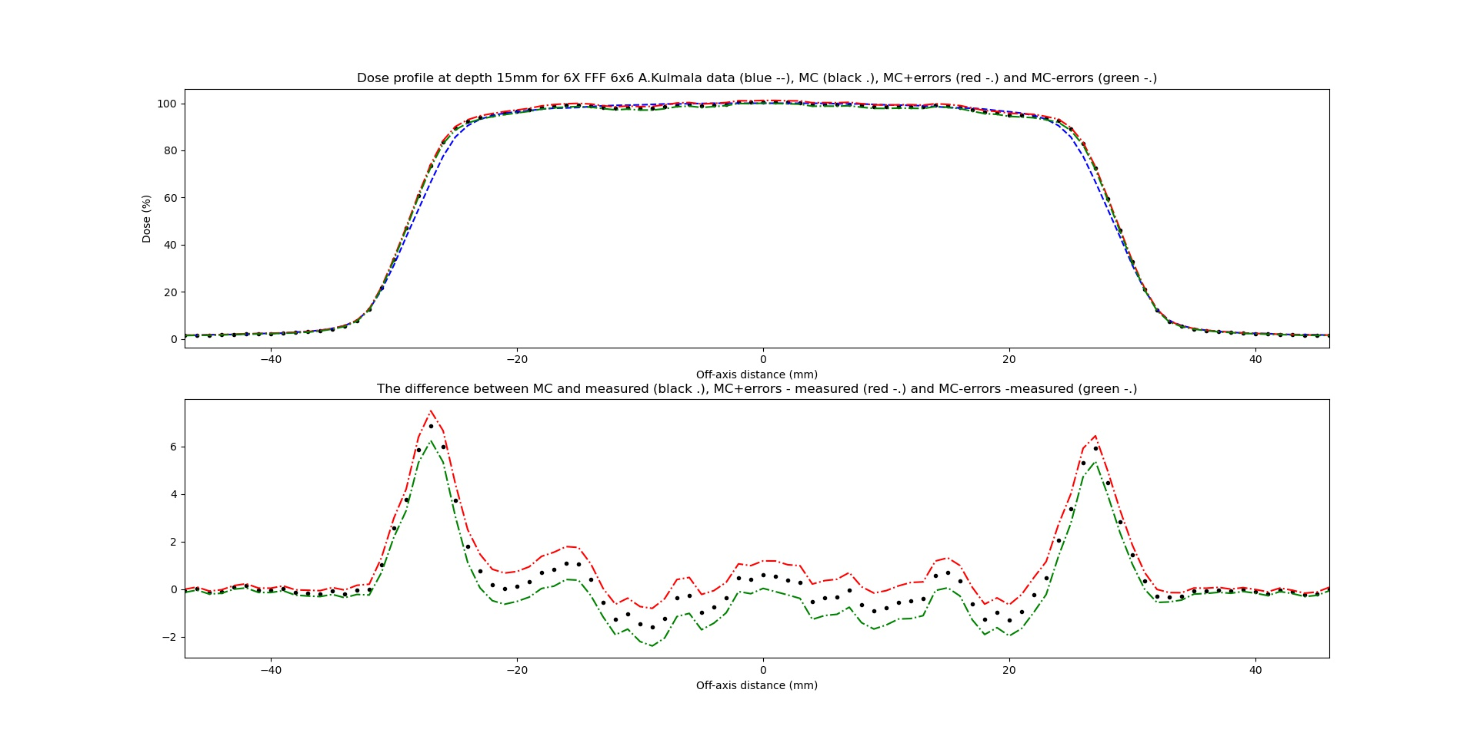

Slide 30
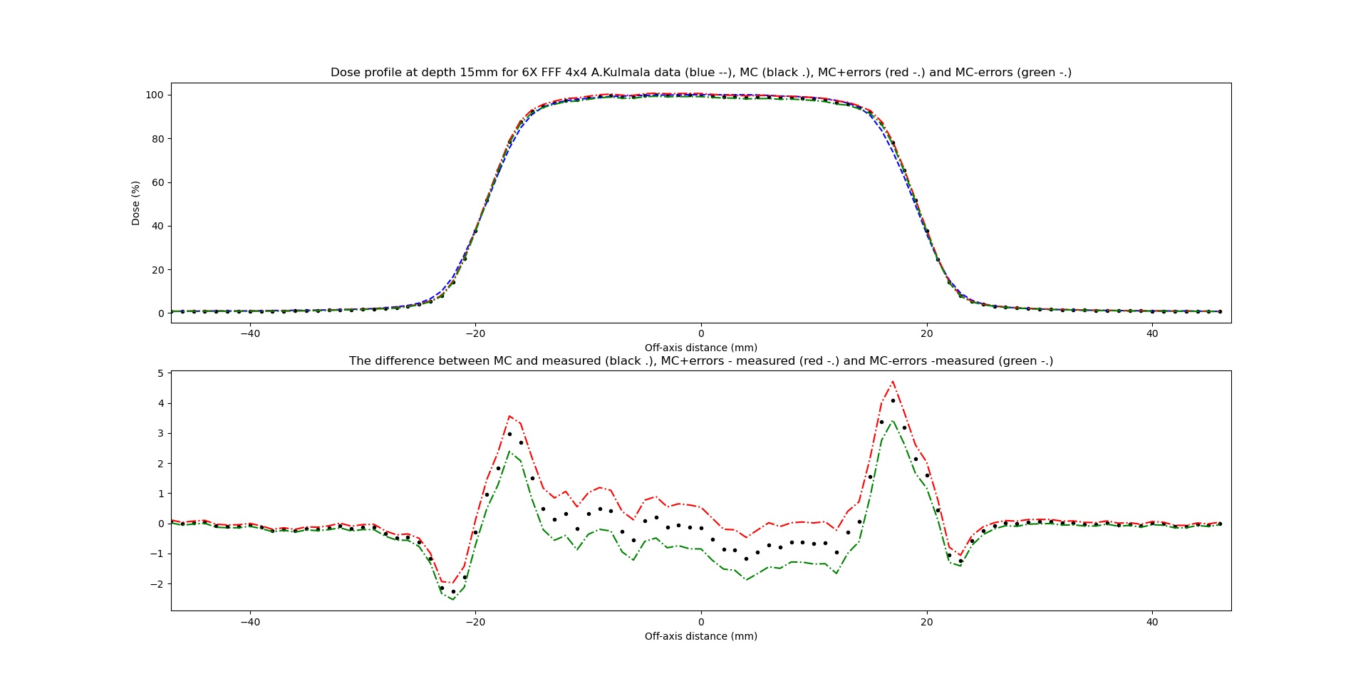
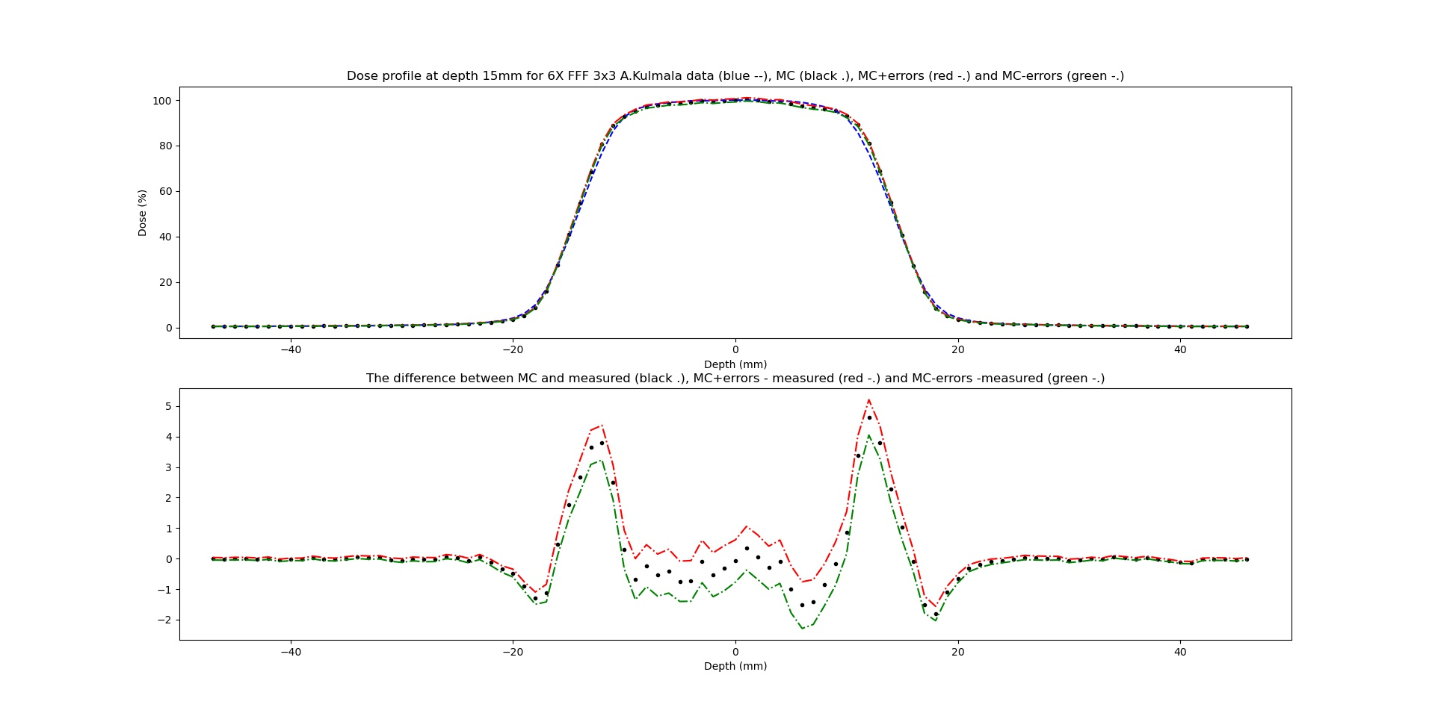

Slide 31
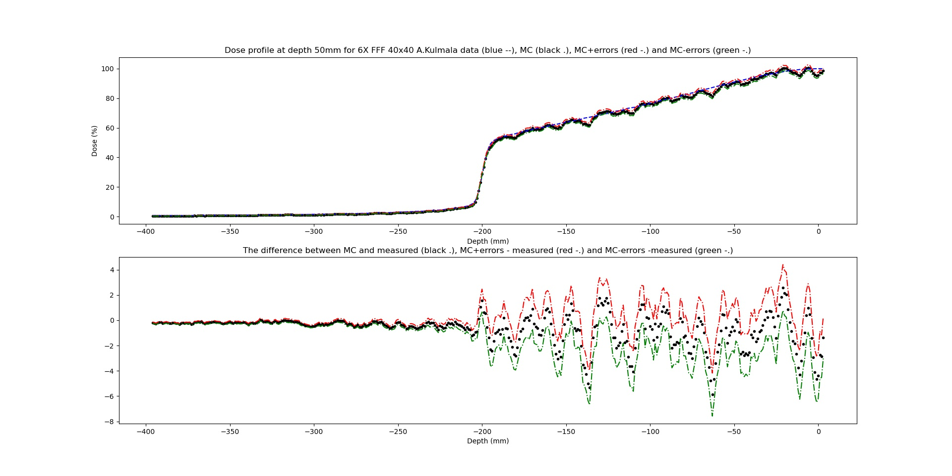
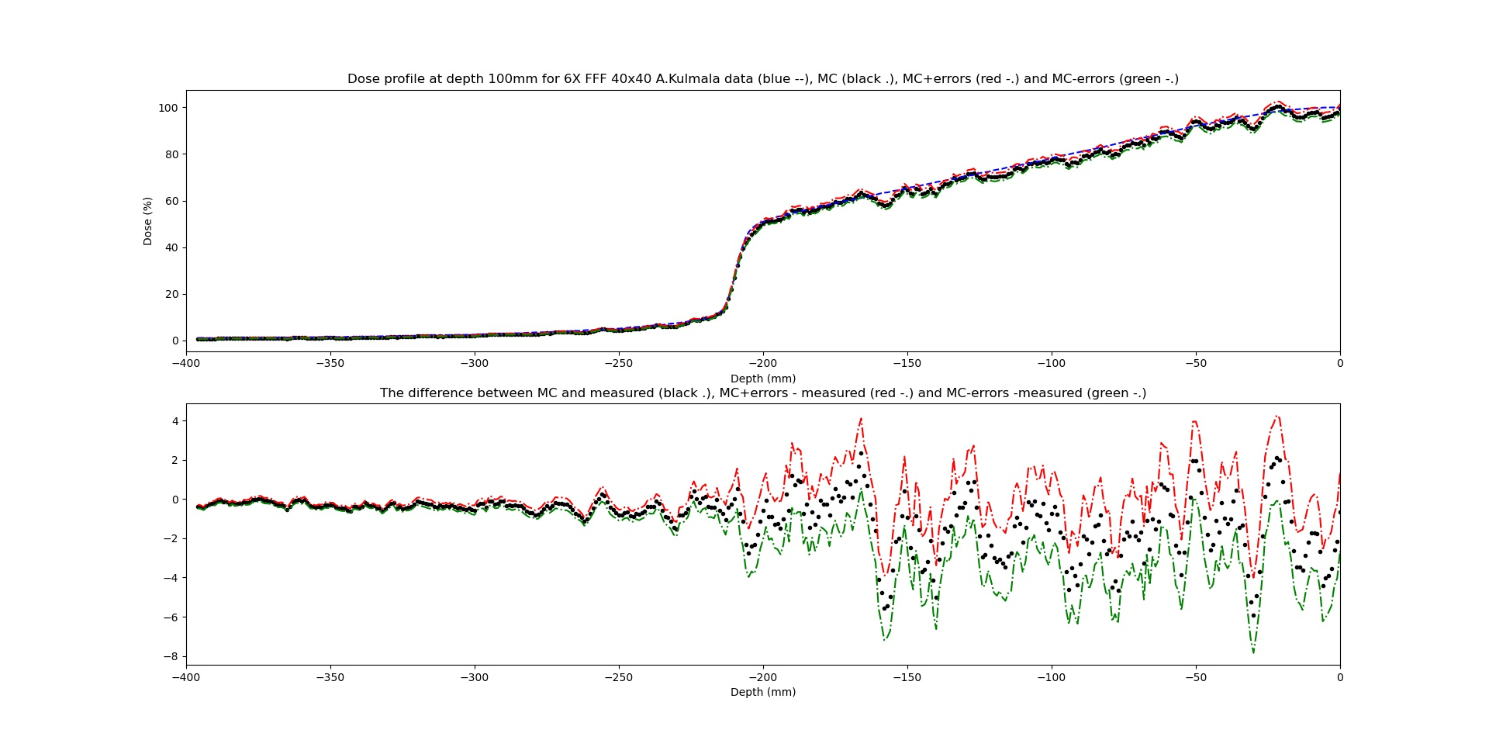
40x40 at depth 50 and 100 mm
Without
With convolution +3mm shift

Slide 32
Diagonals 40x40
Depths: 15mm, 50mm, 100mm, 200mm and 300mm

Slide 33
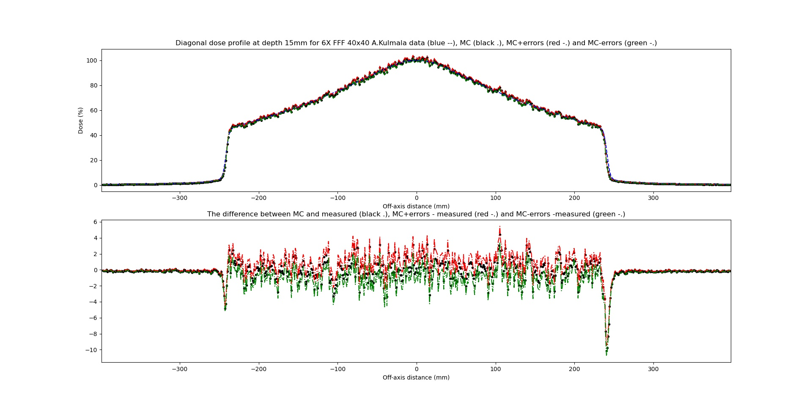
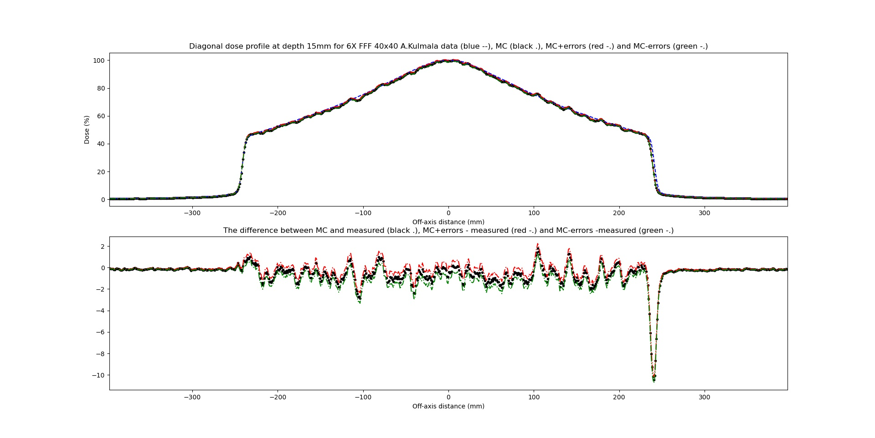
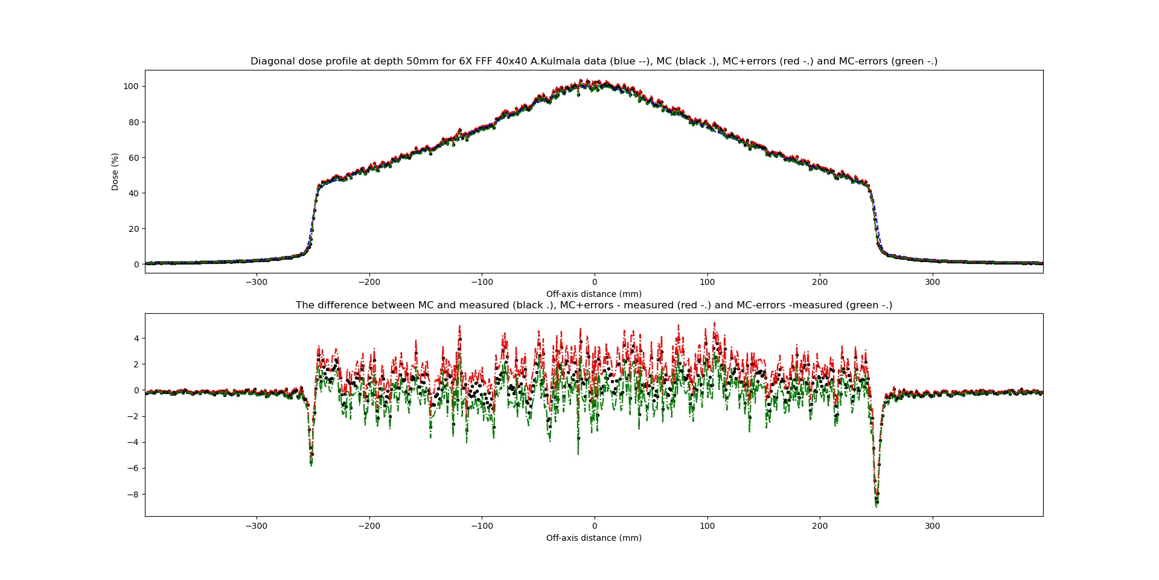
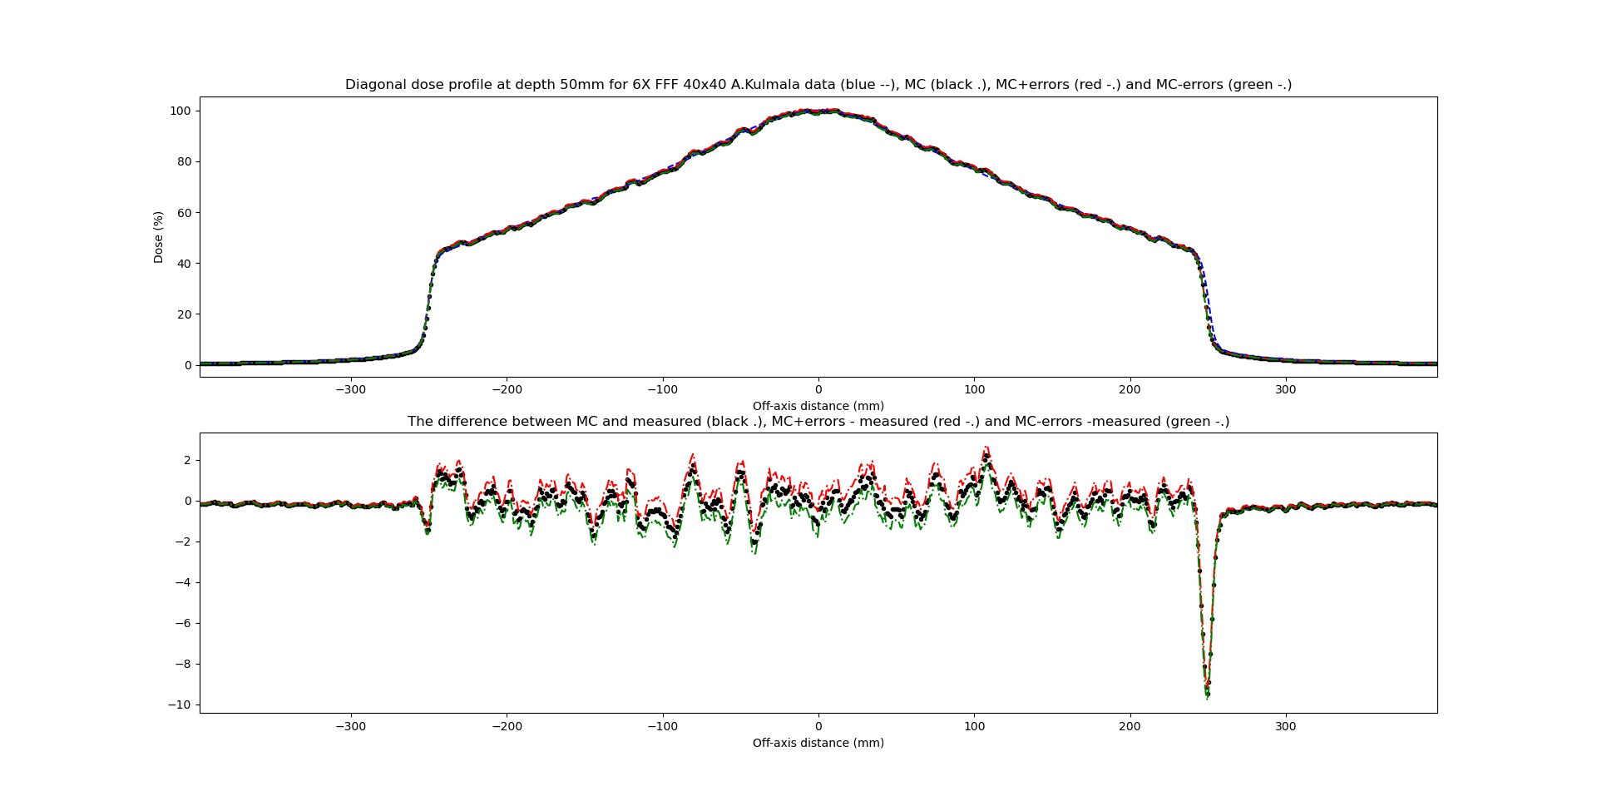
40x40 at depth 15 and 50 mm
Without
With convolution

Slide 34
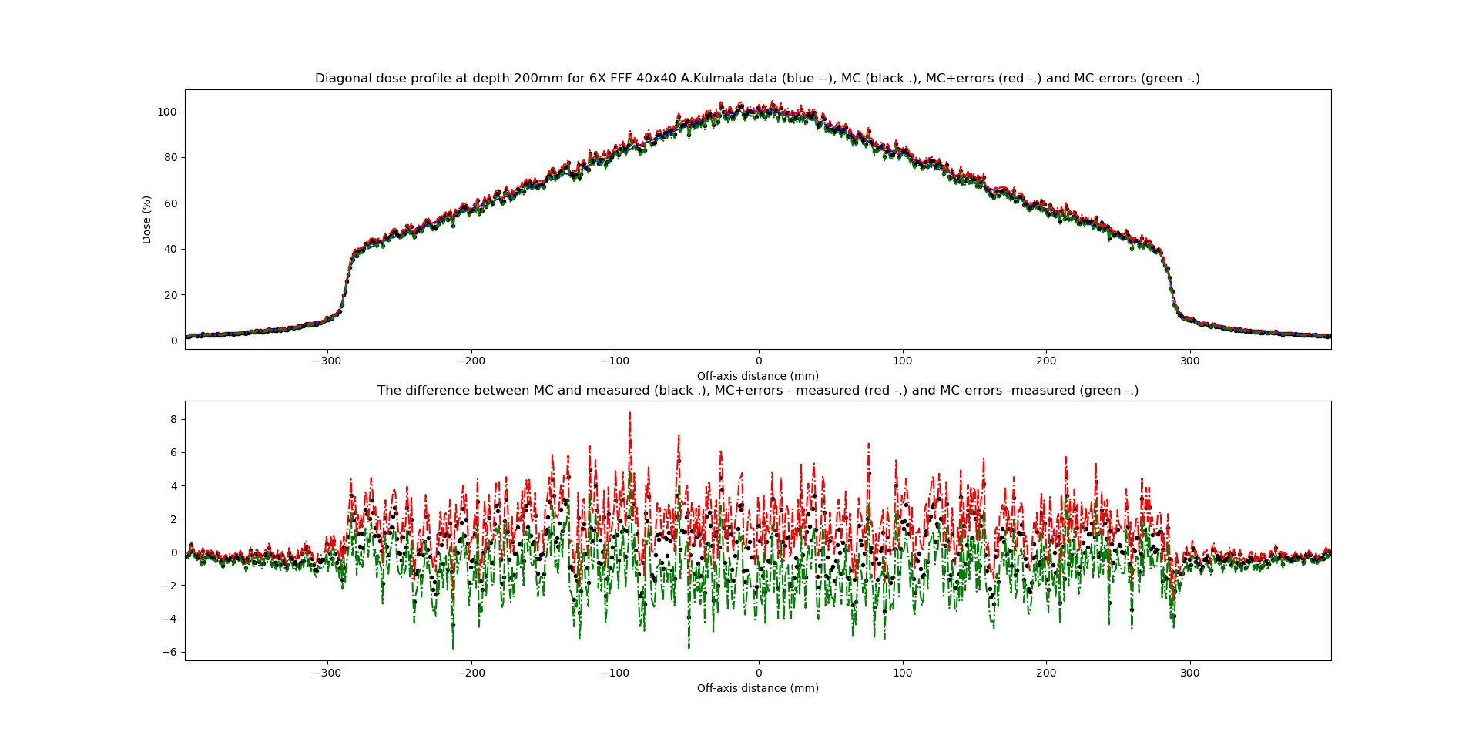
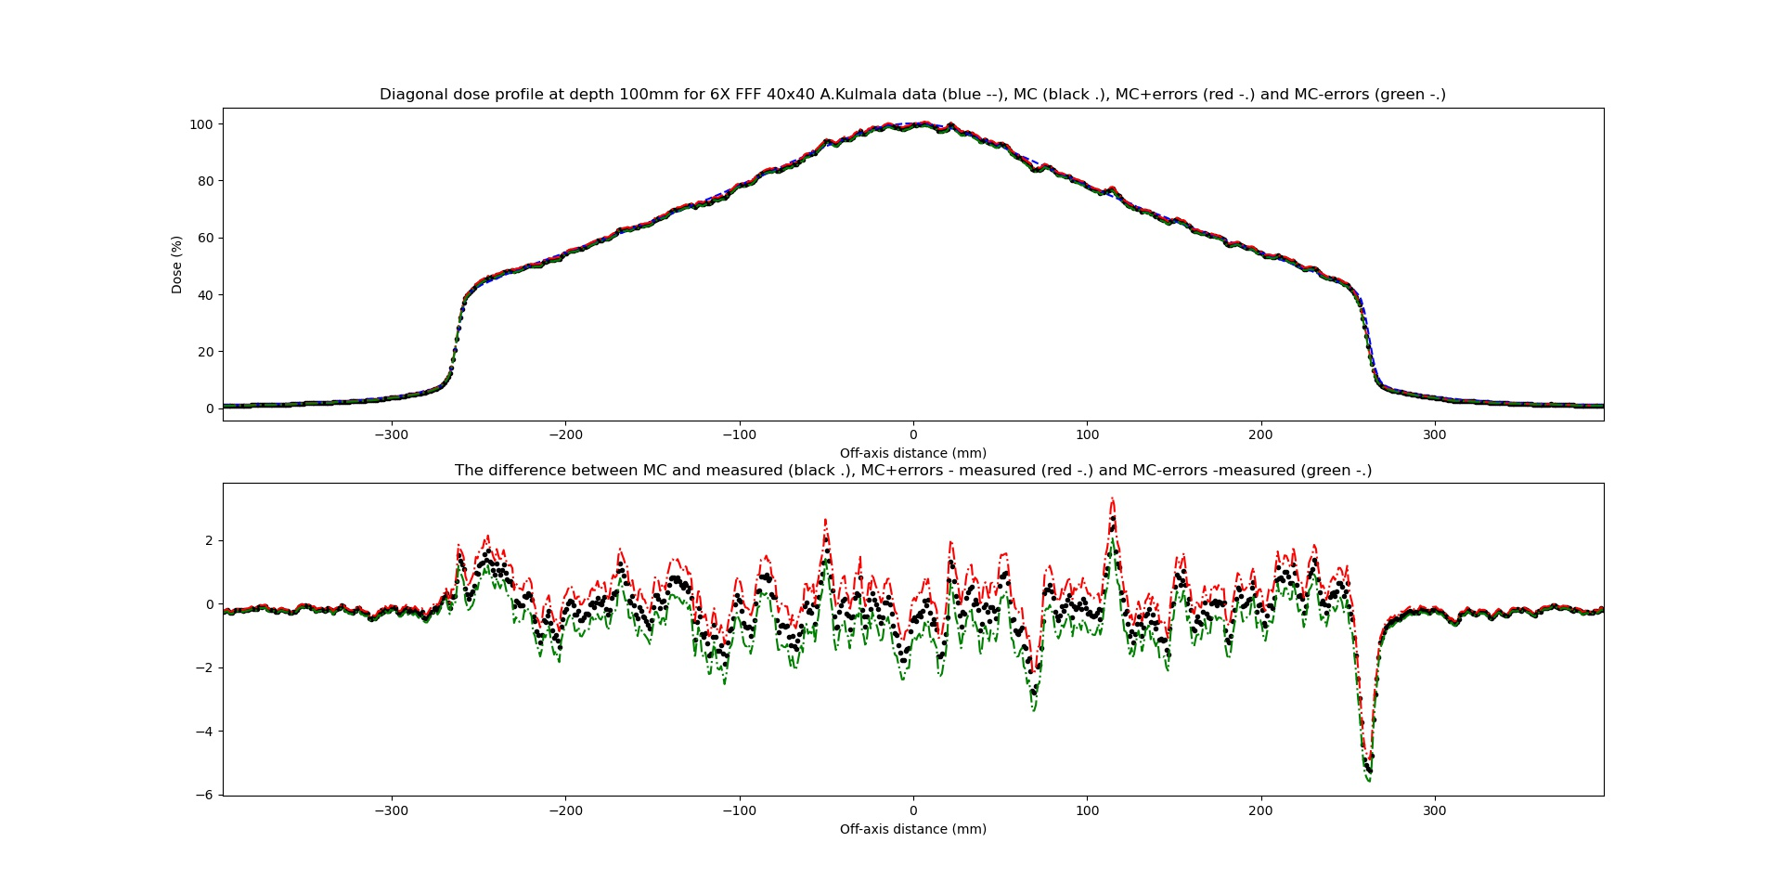
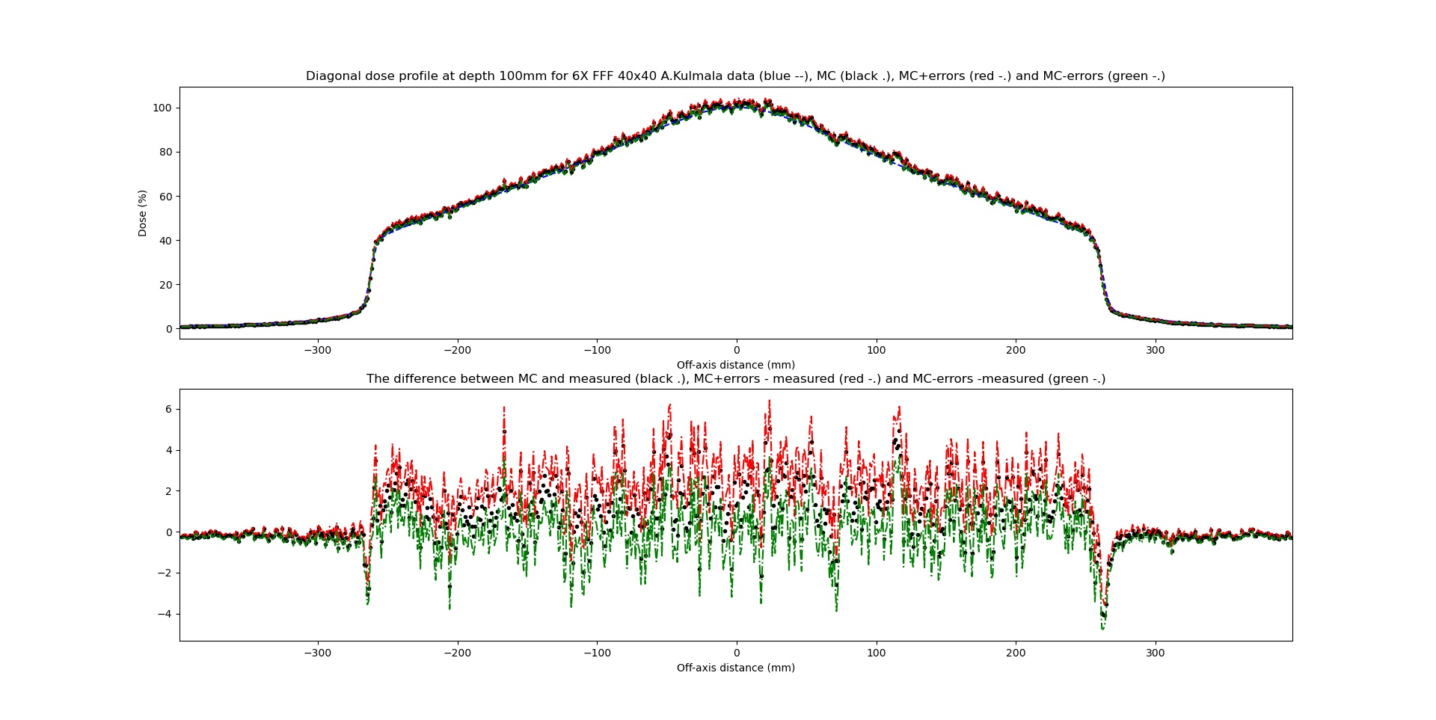

40x40 at depth 100 and 200 mm
Without
With convolution

Slide 35


40x40 at depth 300 mm
Without
With convolution

